Slide 1

Solar energy forecasting
Group 3
Time series analysis project by
Ken ratanavijai
Aamer hussain

Slide 2

Agenda
Introduction
Problem Statement
Business Objective
Assumptions/Hypotheses
Data properties & Exploratory data analysis
Proposed approaches
Results

Slide 3
Assumptions/Hypotheses
Introduction
As the world’s population increases, so does the demand for energy
Solar radiation is a primary driver for many physical, chemical and biological processes on the earth's surface
Solar energy is also a driving force behind number of applications such as photovoltaic systems for electricity generation, solar collectors for heating, solar air conditioning climate control in buildings & passive solar devices
To support this fast-growing market, there is a need for highly accurate, premium solar forecast solutions
To support the ever-increasing need for power and to address mounting environmental concerns, many utilities are seeking sustainable power sources to augment traditional ones
Technological advancements and rapidly dropping costs have spurred the growth of environmentally friendly solar power

Slide 4
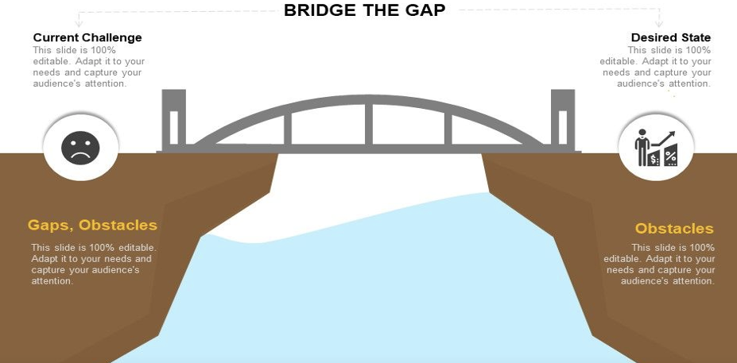
Problem Statement
Reduction of penalty costs by improving the forecast in a Concentrating solar power plant
20% to 40% Solar Renewable energy is wasted due to variability
Forecast errors involve significant costs
Accurate forecasts are required to optimize operational planning of solar-power plants
Simplifies the process of energy assessment & Enable solar investors to maximise profitability

Slide 5
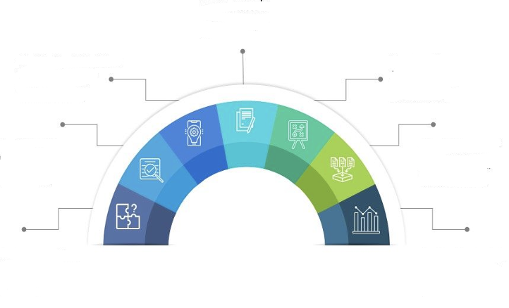
Business Objective
Finalizing the mechanism for Forecasting, Scheduling and Deviation Settlement of solar projects
Enhanced distribution system control and system reliability for distributed solar operations
Improved power marketing choices for solar companies for better financial results
Enhanced generation planning & dispatch for expanded use of solar power
Improved ability to meet ISO/TSO commitments
Accurate forecasts can have money-saving and operational benefits
Reduced spinning reserves costs

Slide 6

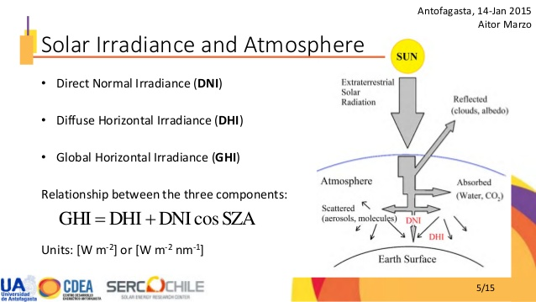
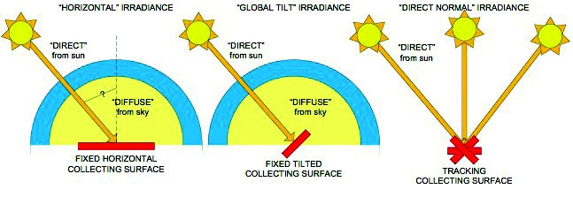
Data Source
Solargis maintains fast access to historical, recent, and forecast data for almost any location on the Earth.
Diffuse Horizontal Irradiance is the amount of radiation received per unit area by a surface that does not arrive on a direct path from the sun, but has been scattered by molecules and particles in the atmosphere. Basically, it is the illumination that comes from clouds and the blue sky.
This data is mostly used by photovoltaic software applications & to optimise construction, evaluation and management of solar power assets.

Slide 7
Assumptions
The data not capable of accurately representing the local microclimates, especially in mountainous and coastal zones. This also means that complex areas with lot of contrast are more prone to see higher deviation
Site data generated for the location Plataforma Solar de Almeria, Spain
Coordinates: 37.094416°N, 2.359850°W
Elevation: 497.0 m a.s.l
Monthly Data – (1994 –2019)
Places with higher bias between measured and modelled data are typically located next to mountain areas, coast places and in general areas where the landscape and microclimatic conditions changes more intensively and less gradually.
very extreme weather phenomena cannot be estimated with high precision using modelled data.
A correct evaluation and interpretation of uncertainty is very much related to expert decision making based on the knowledge collected from the experience in working with the data
Looking at the bias statistics, it is also to be noted that the deviations during night-time are usually higher, i.e. the values provided during the solar power generation hours are in general estimated with lower uncertainty.

Slide 8
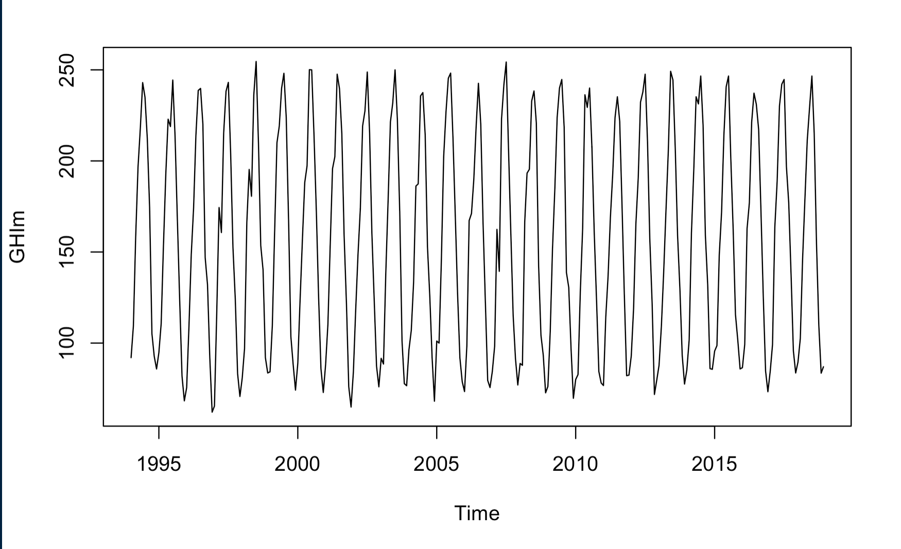
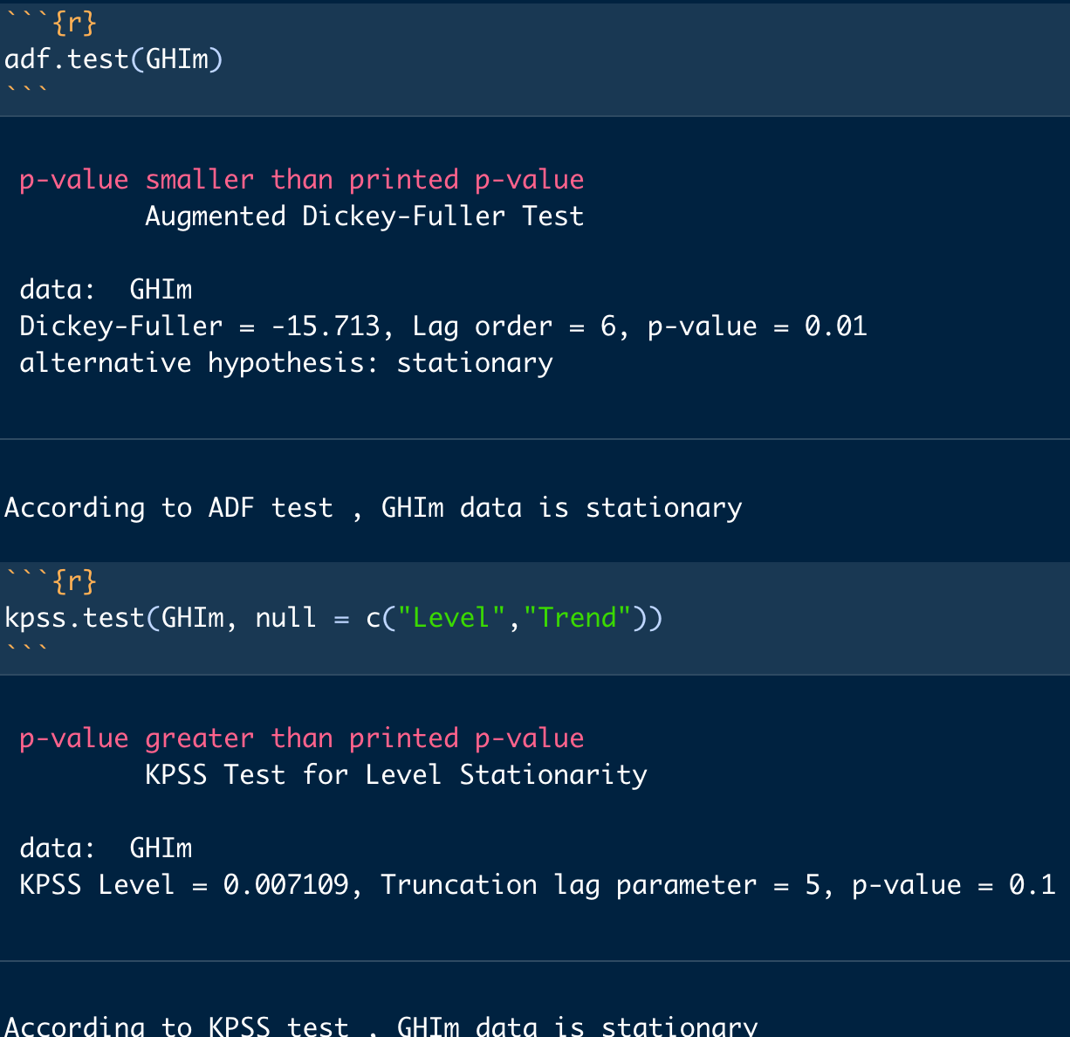
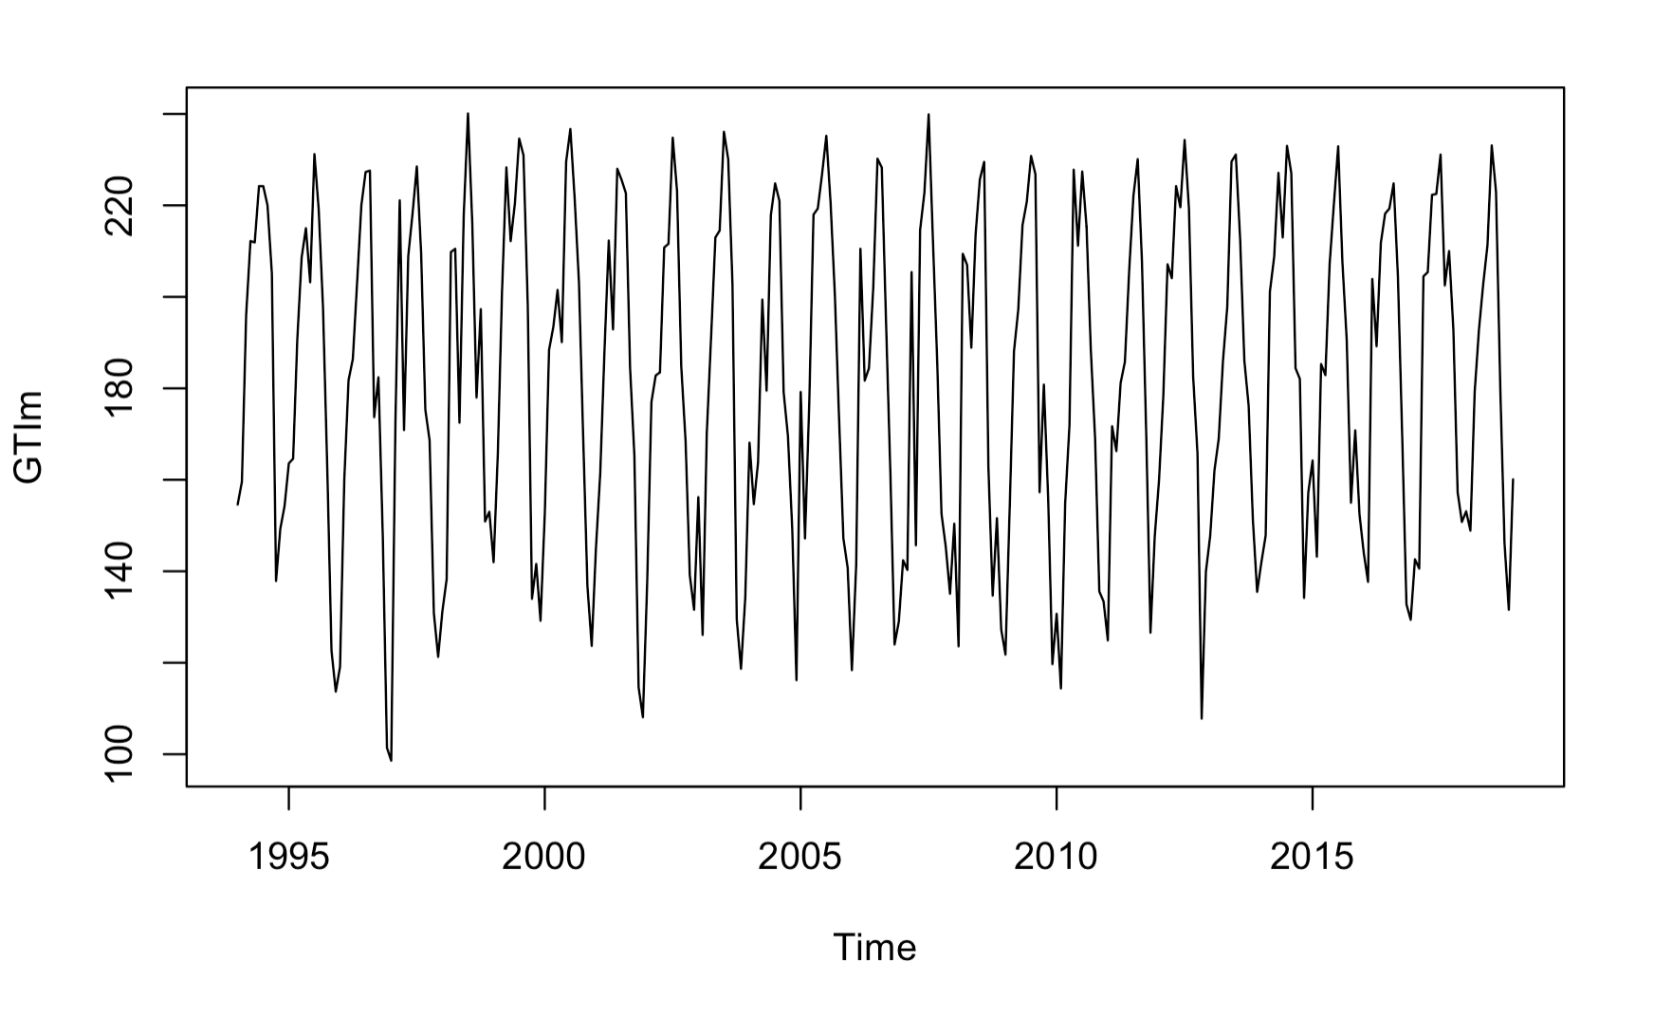
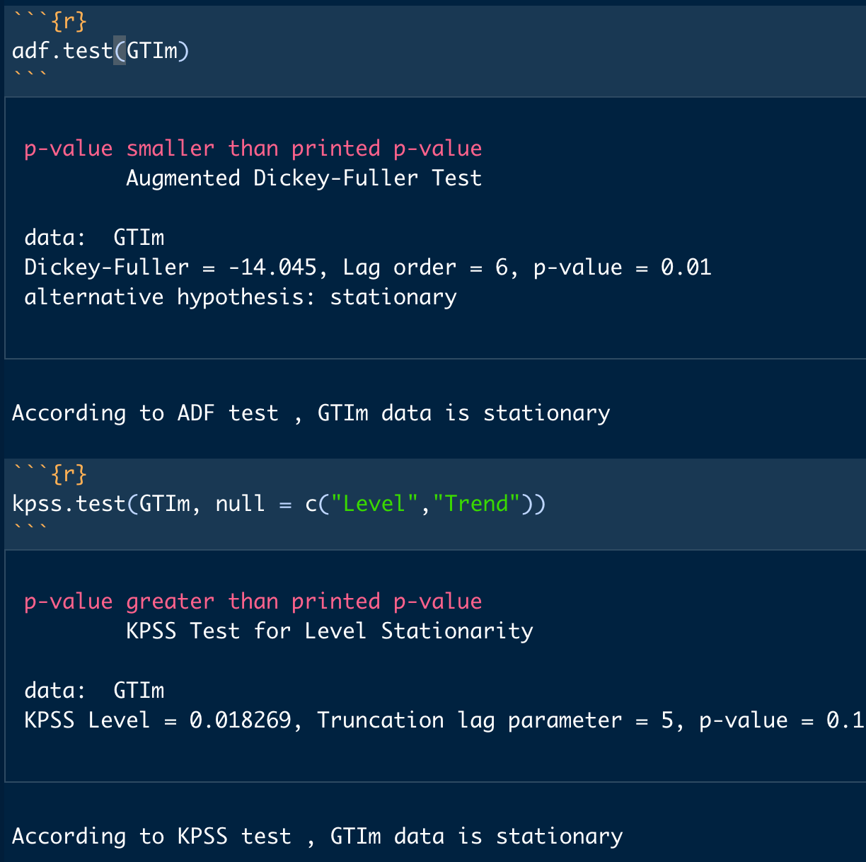
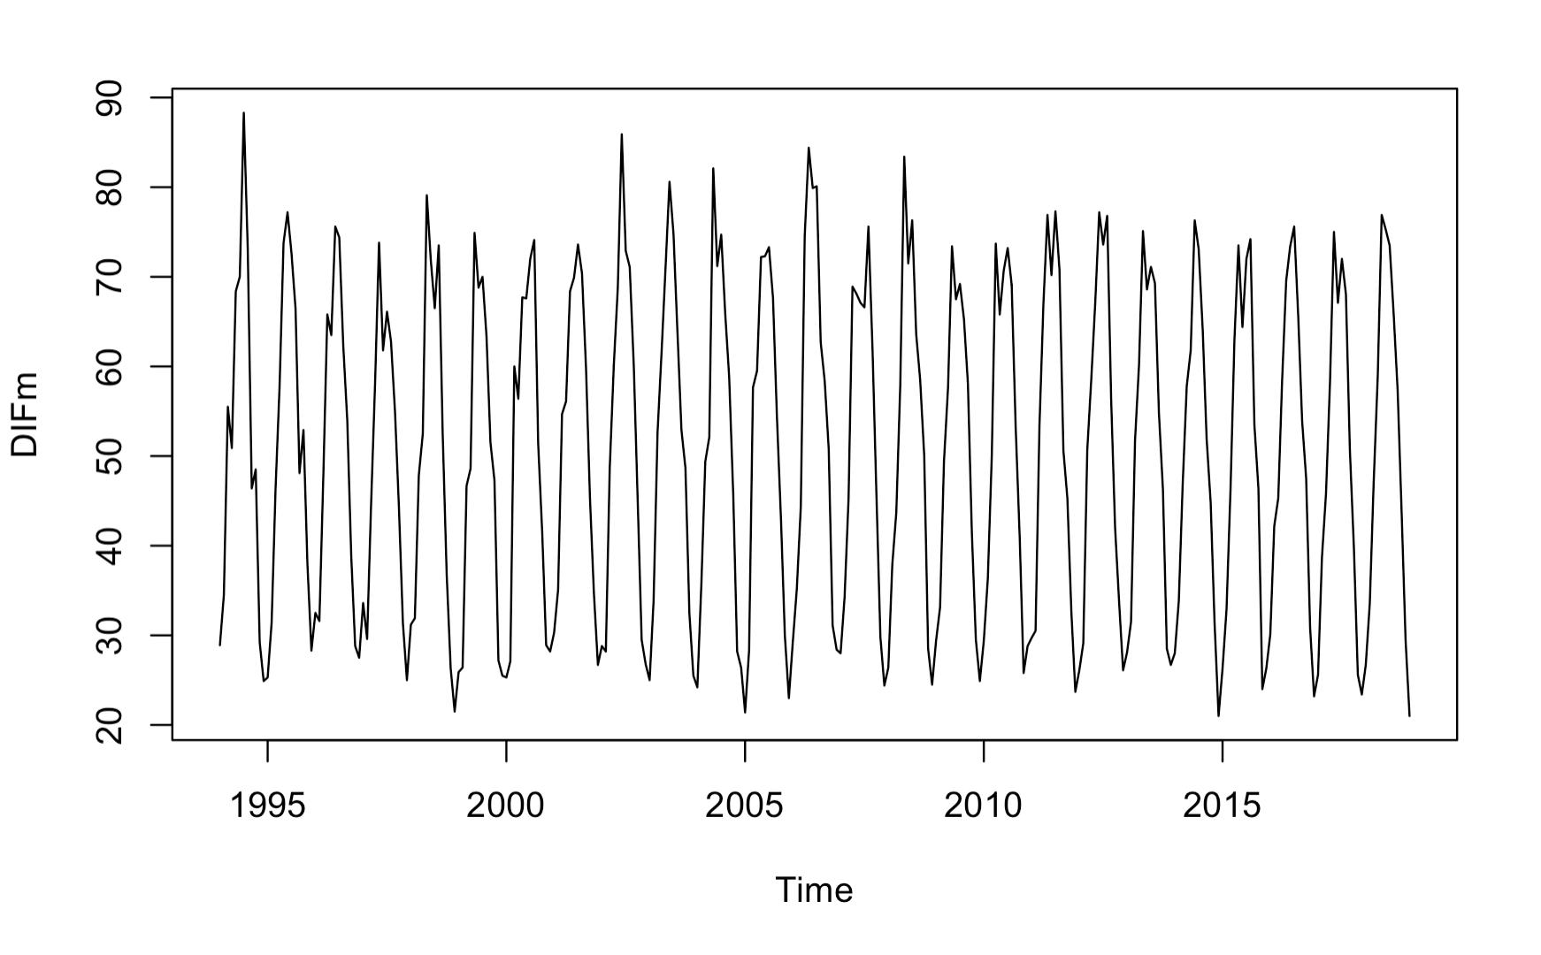
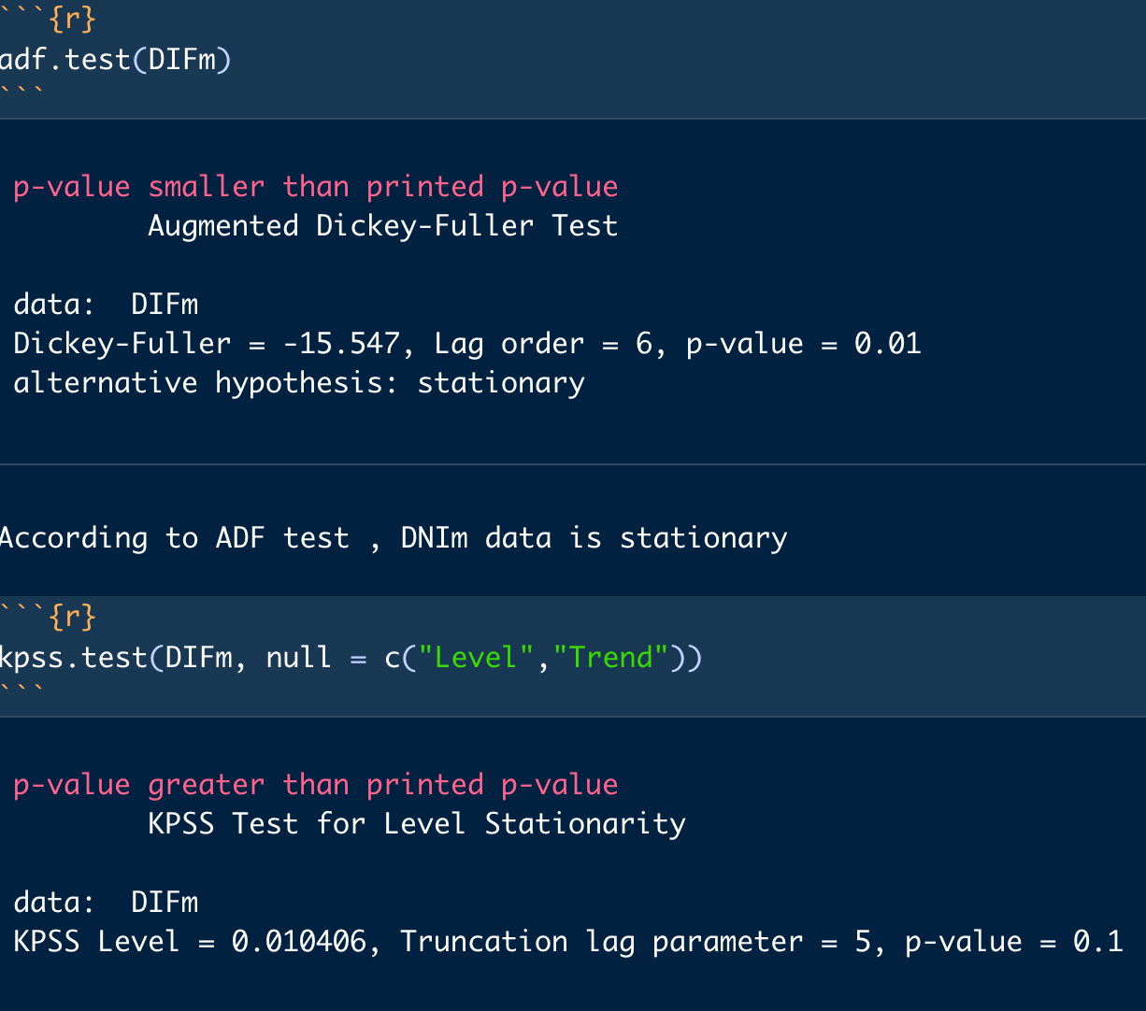
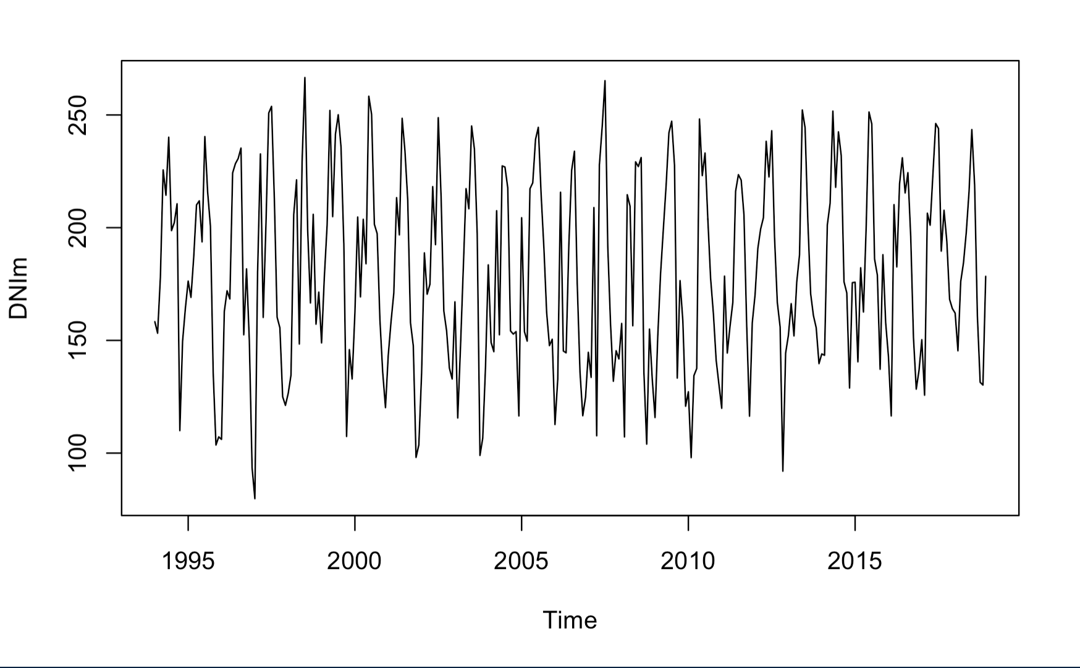
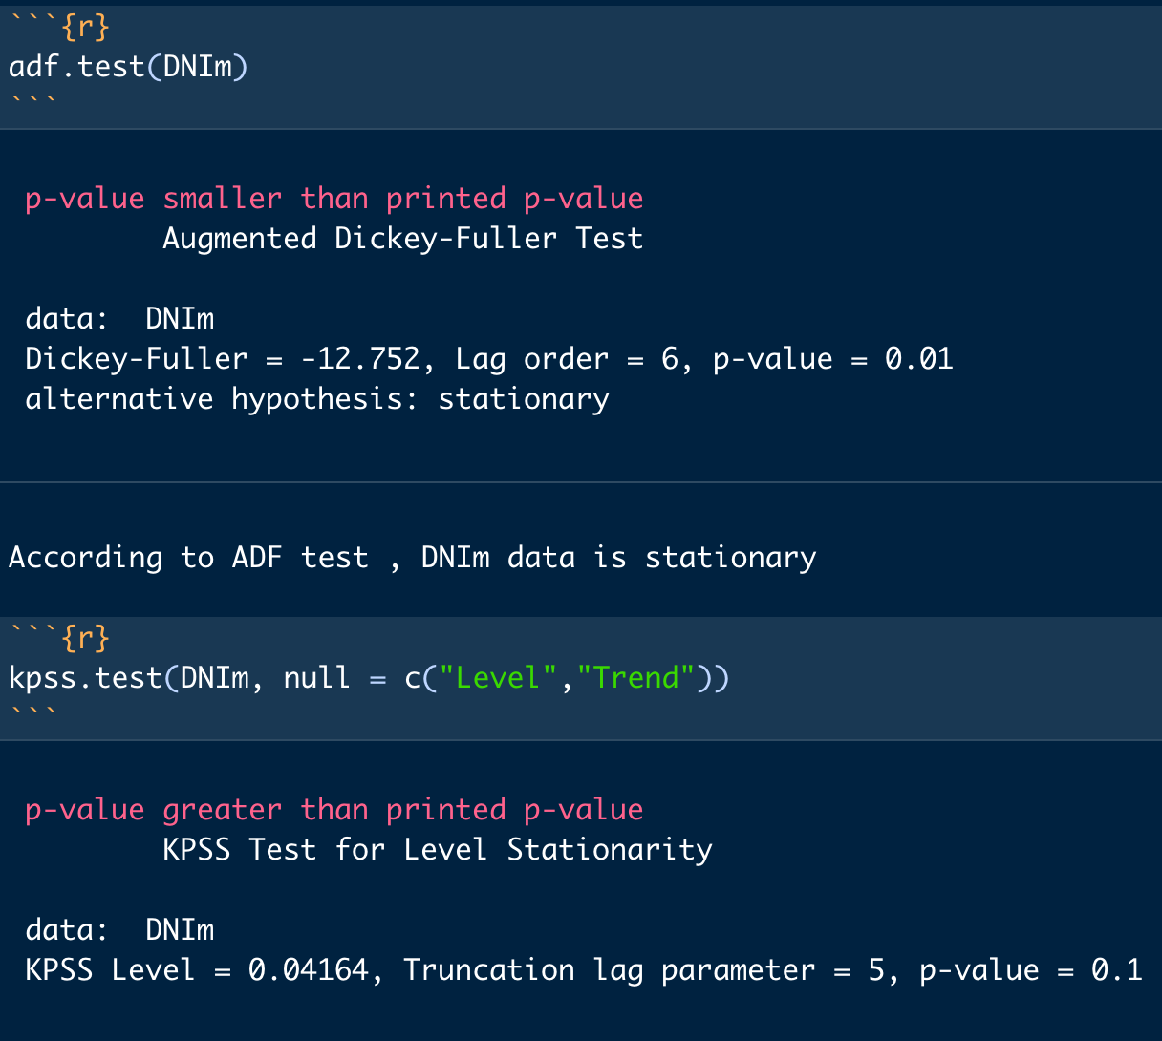
Data Properties / Stationarity tests
GHIm
GTIm
DIFm
DNIm

Slide 9
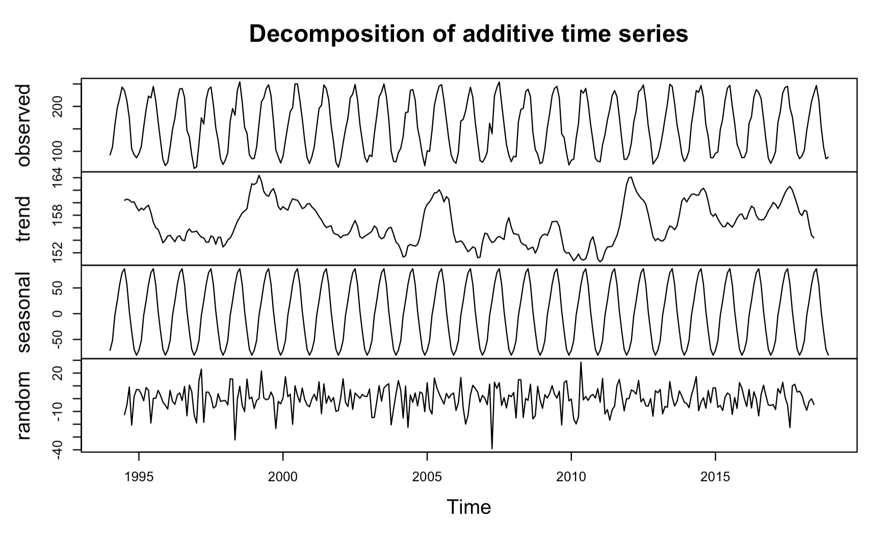
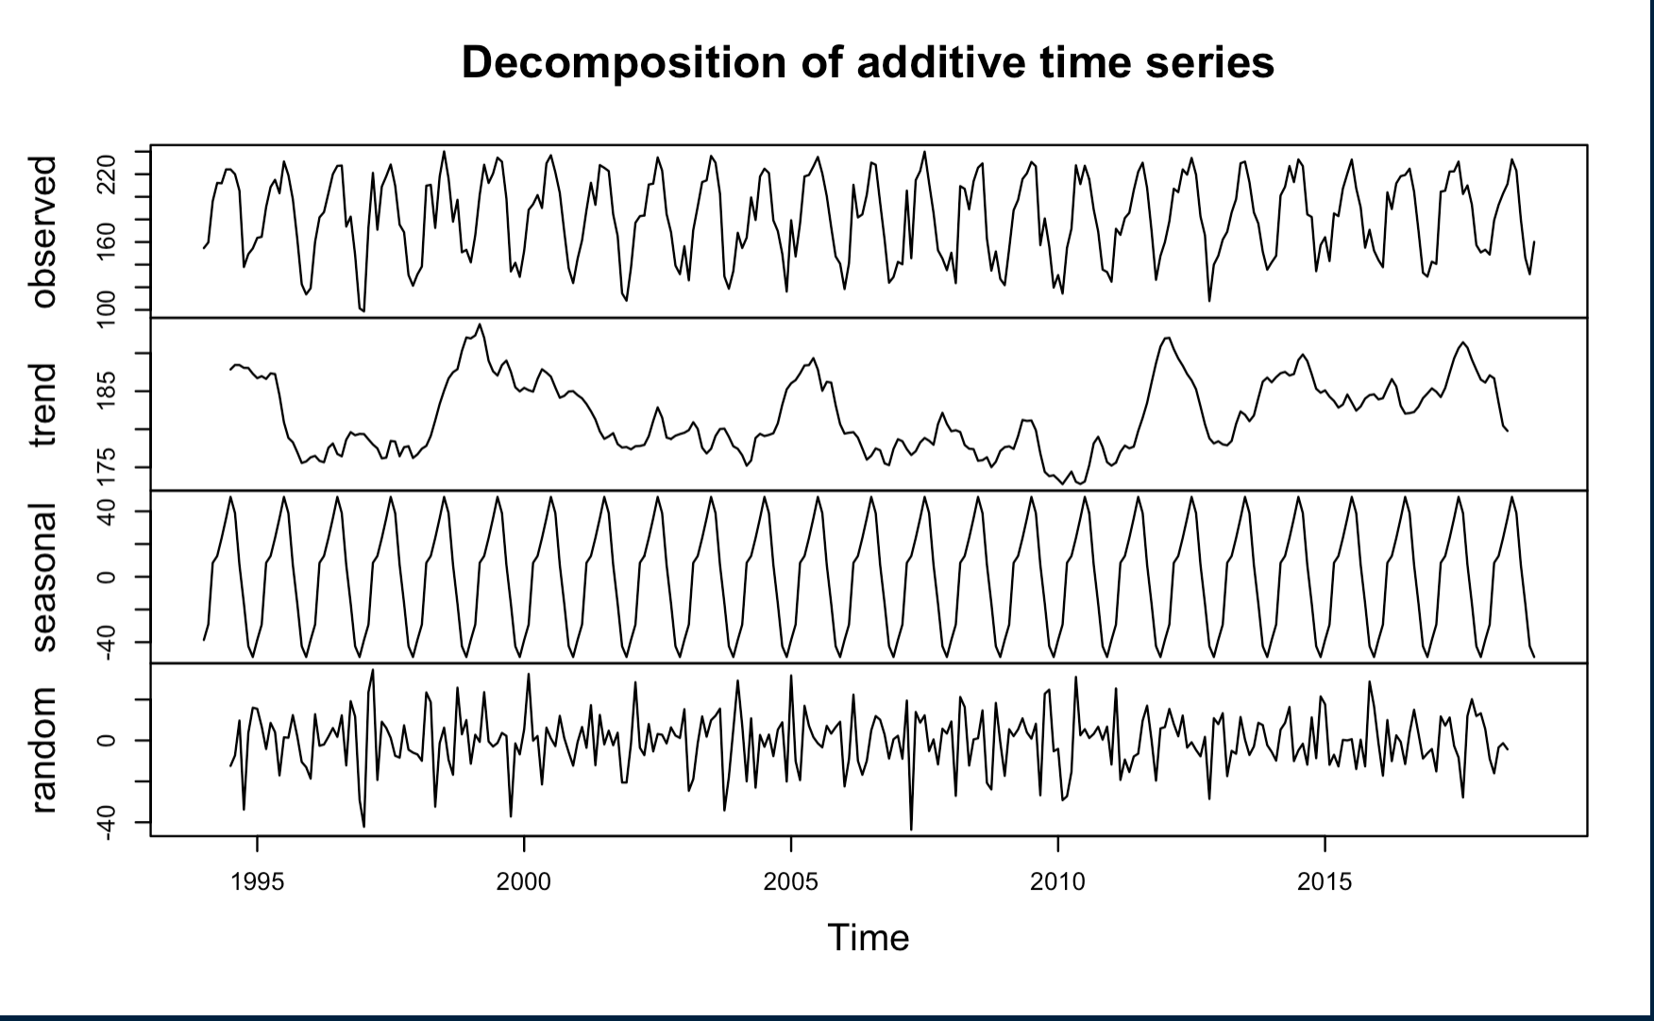
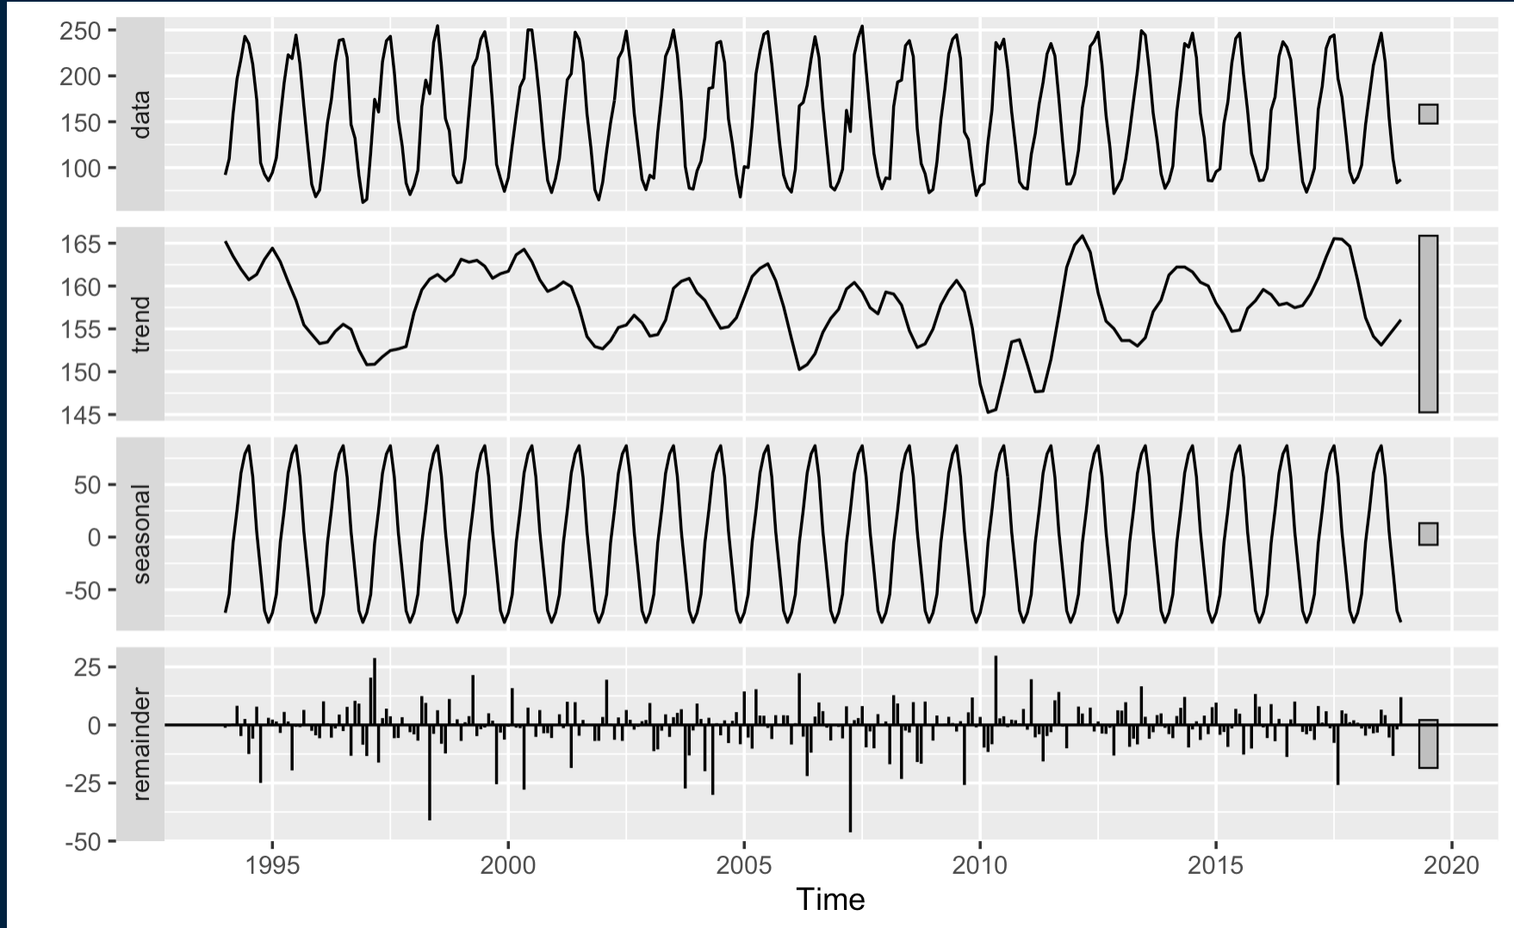
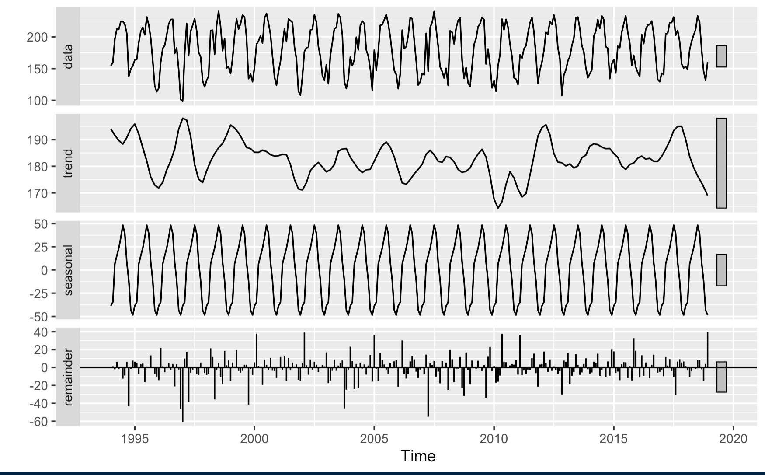
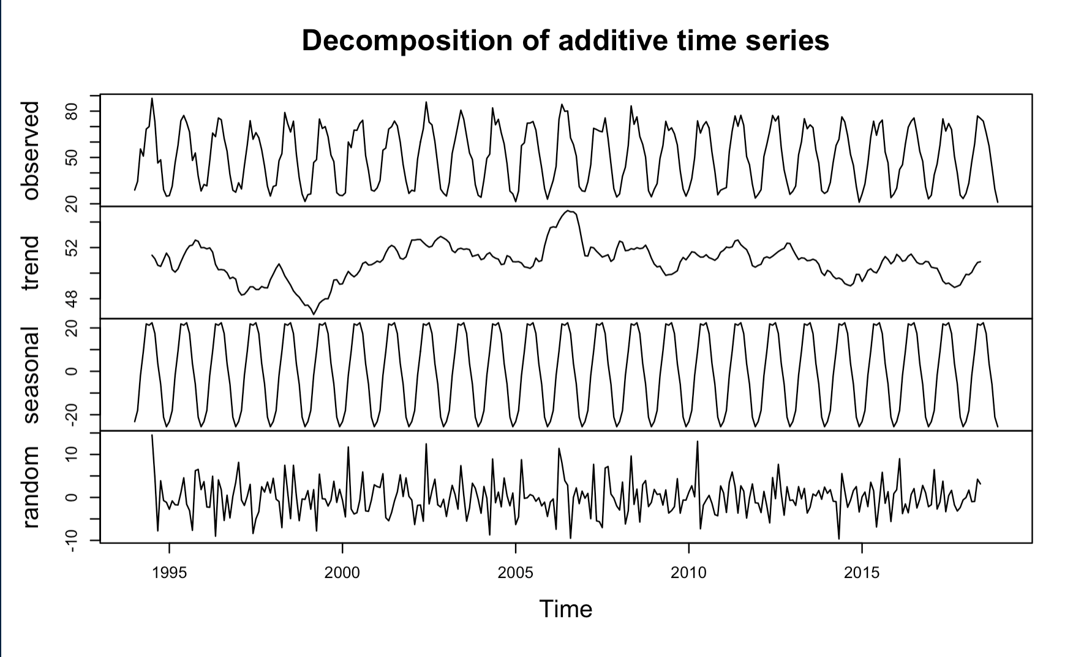
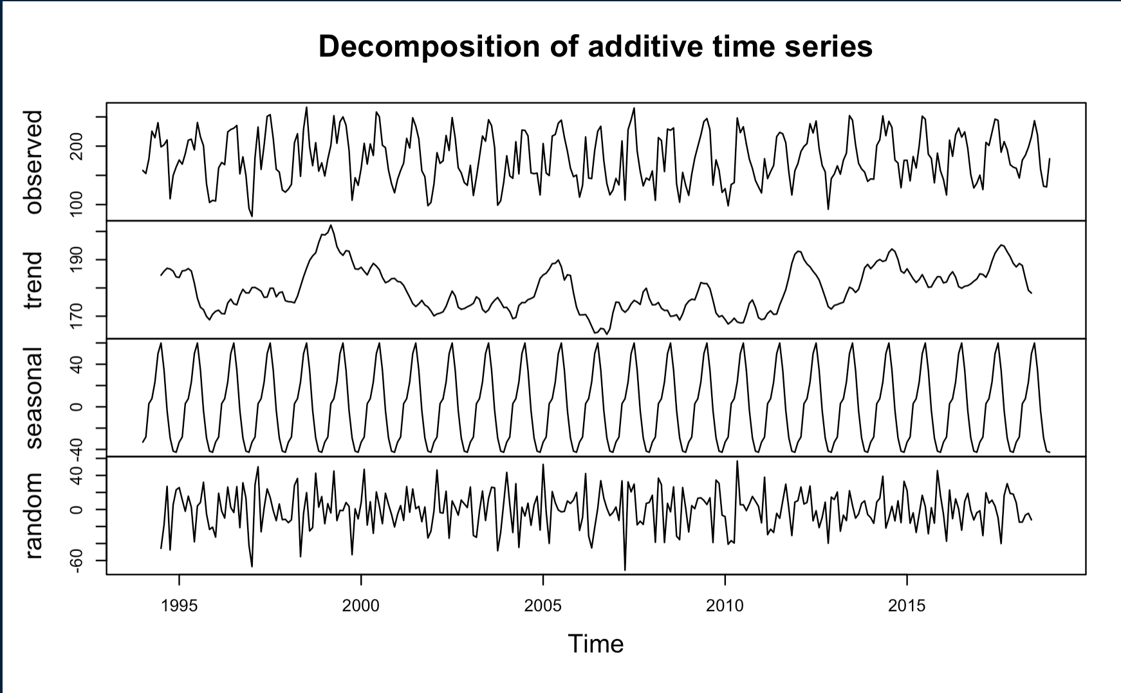
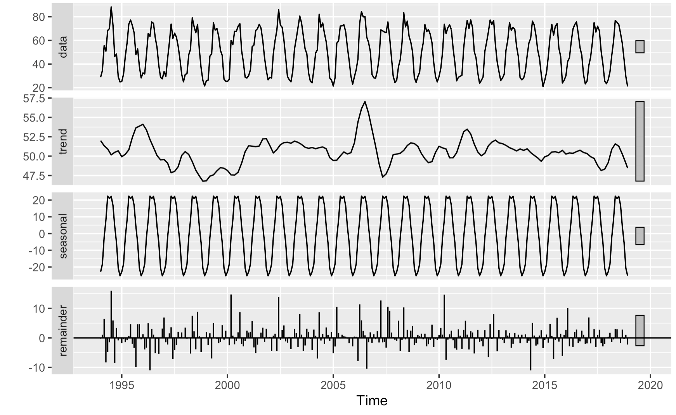
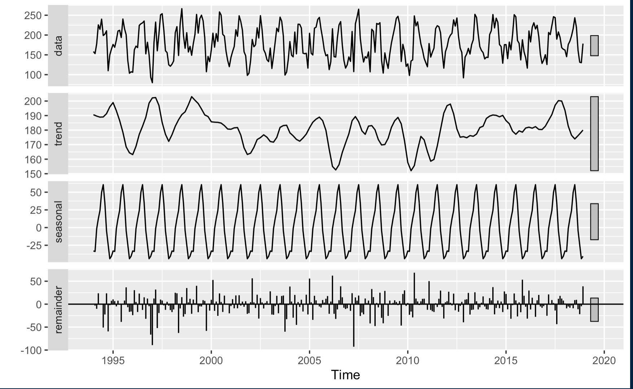
Decomposition
STL Decomposition
GHIm
GTIm
GHIm
GTIm
DIFm
DNIm
DIFm
DNIm

Slide 10
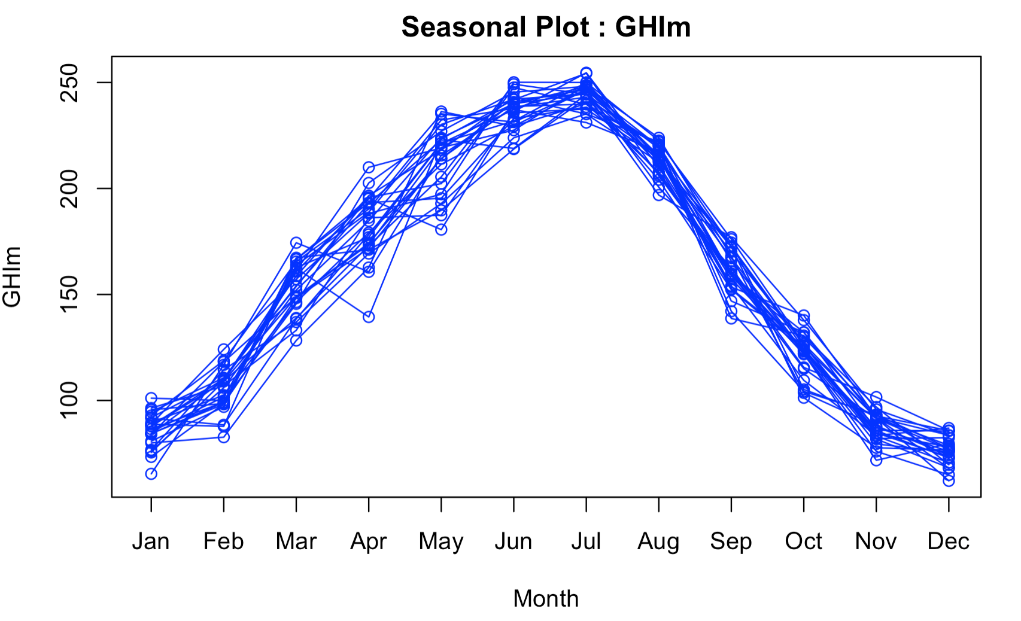
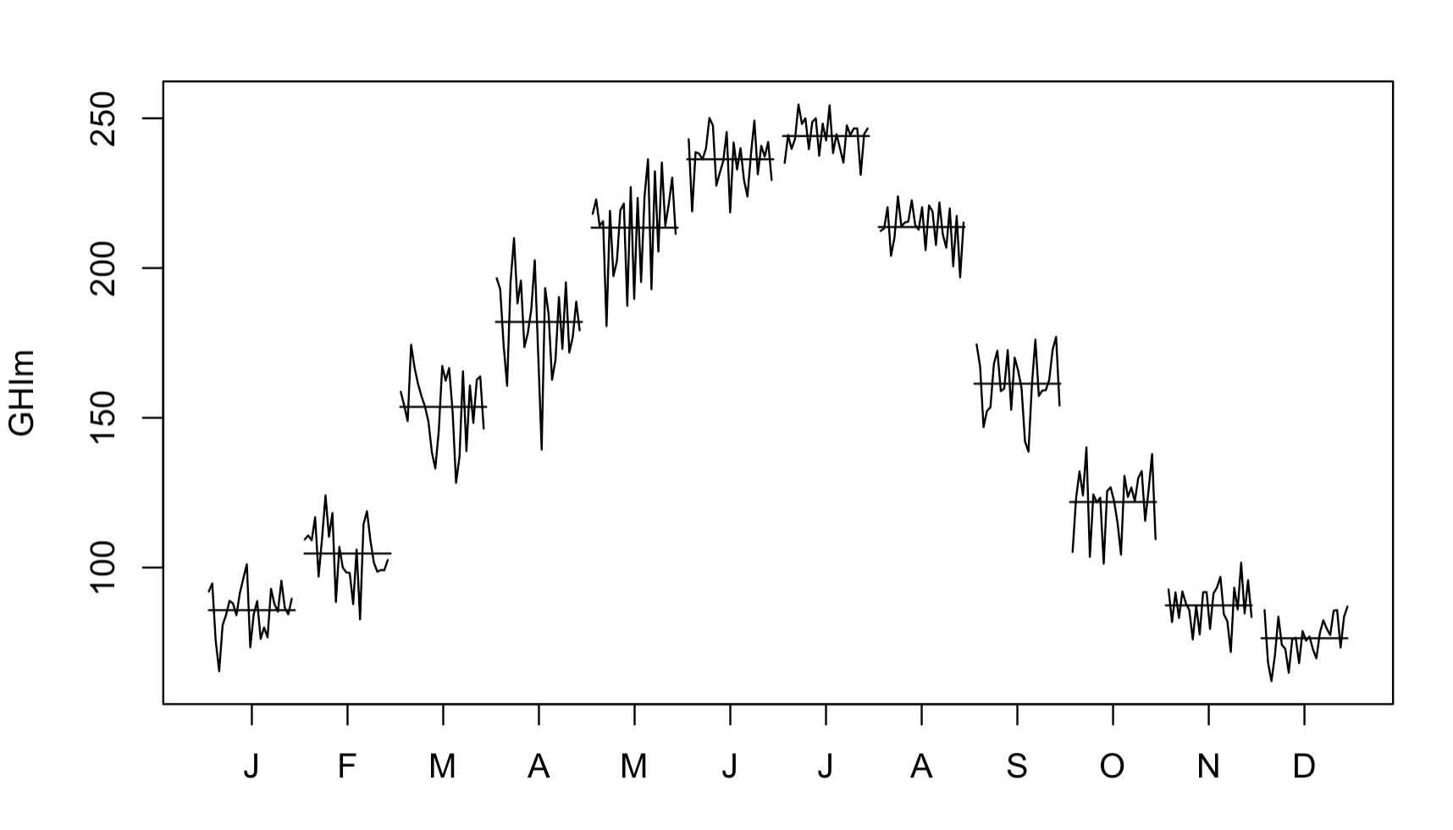
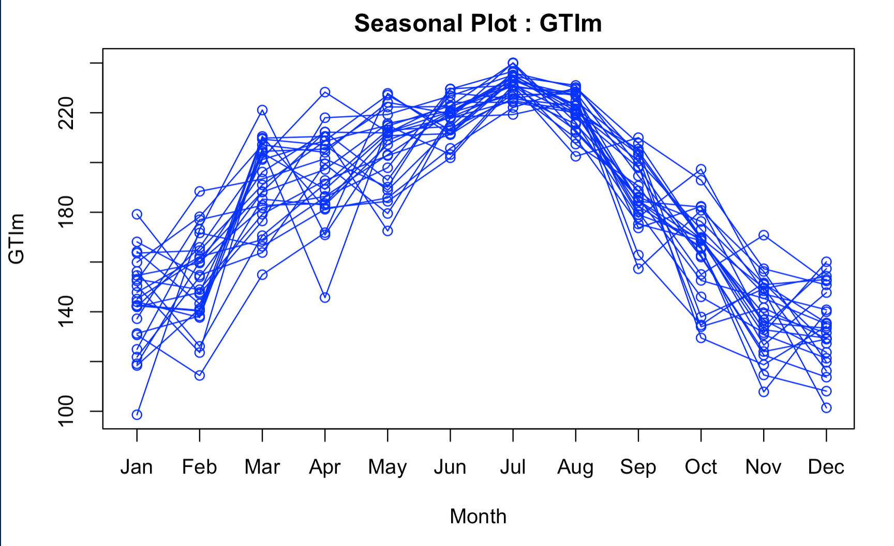
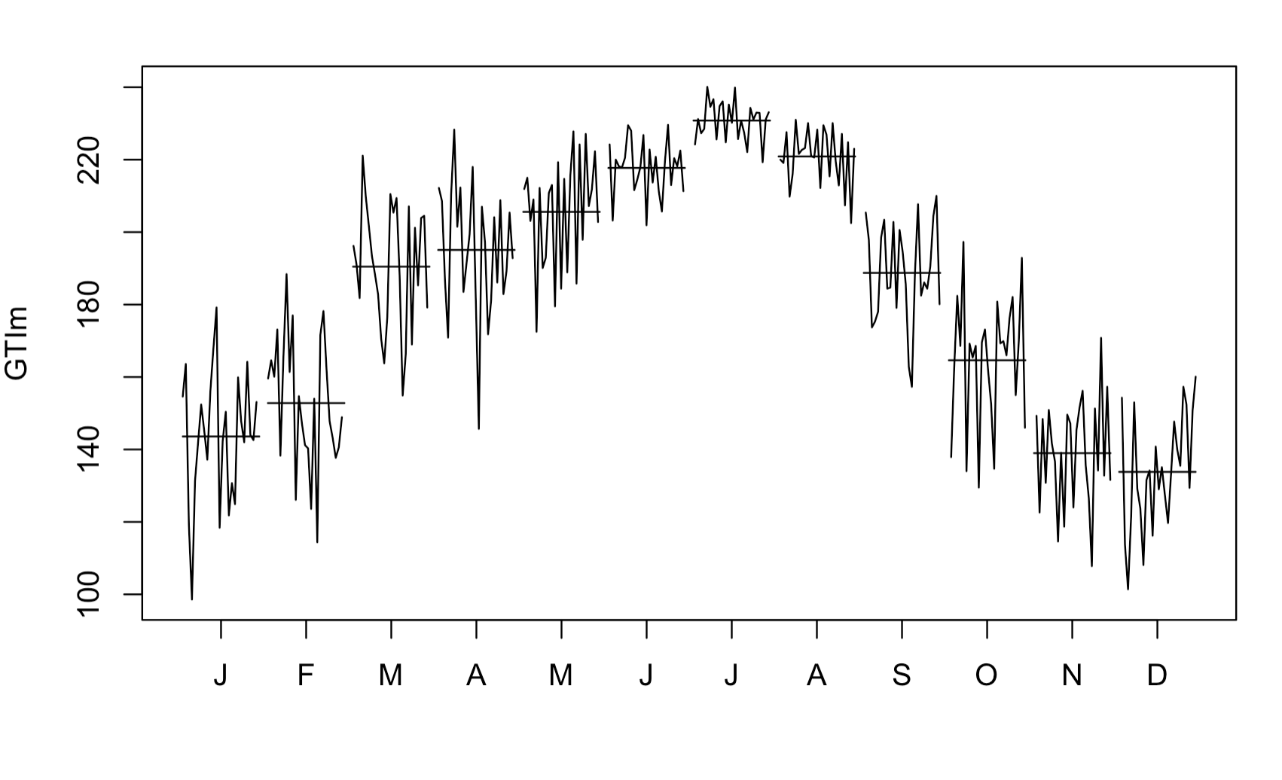
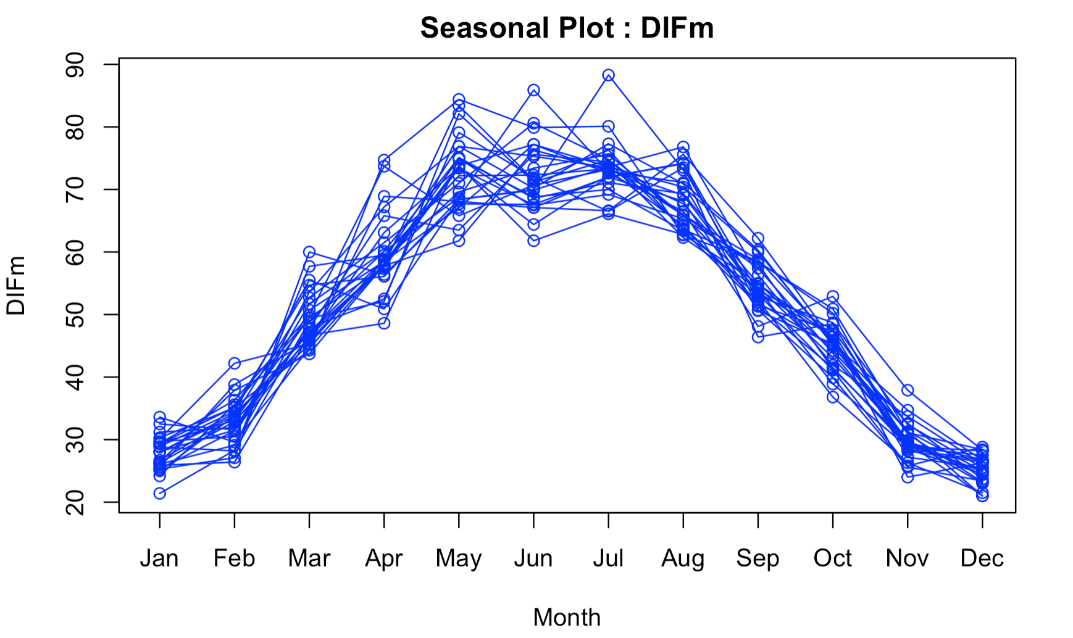
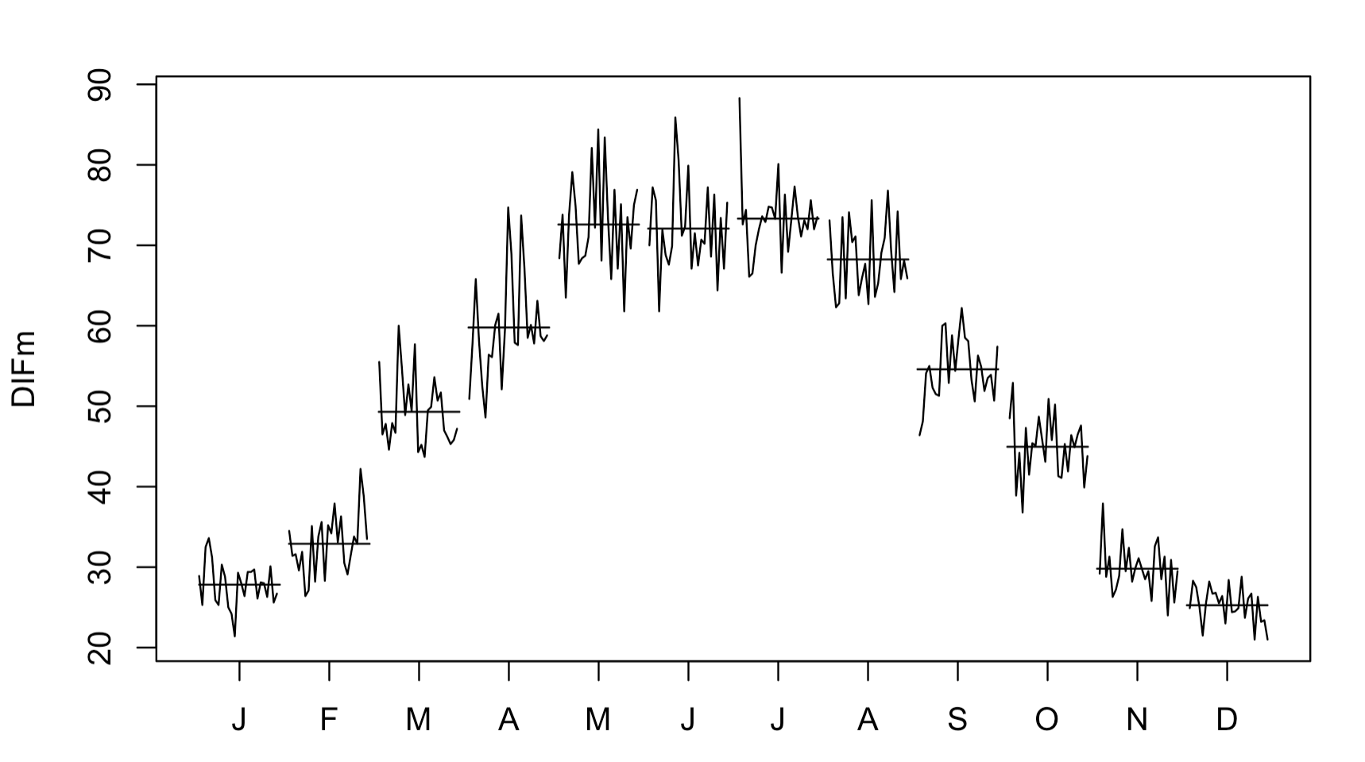
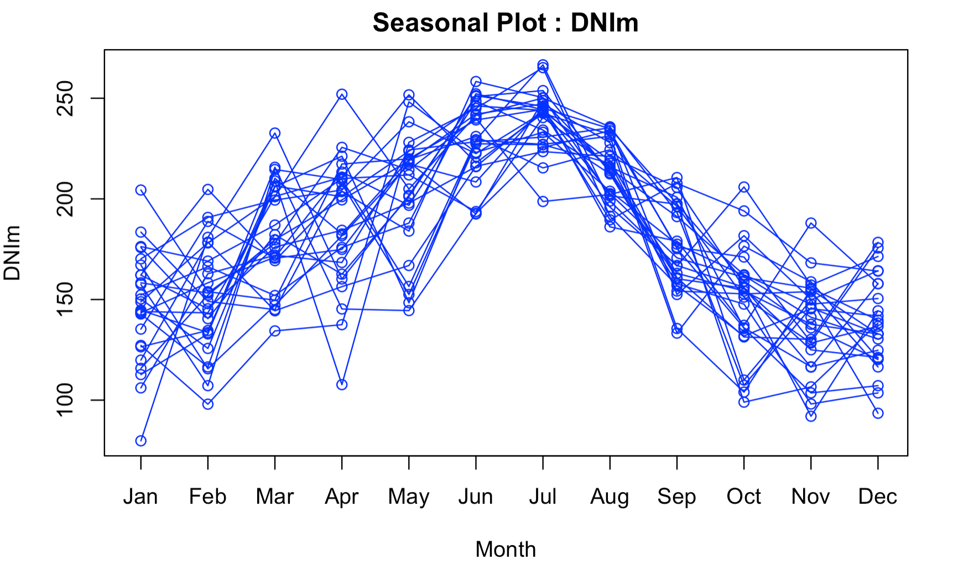
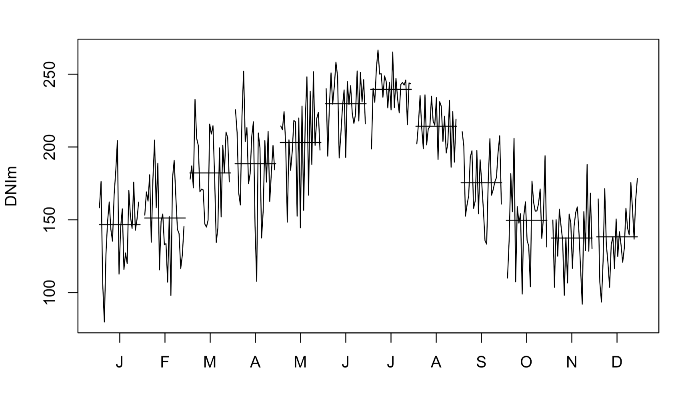
Season/Month plots
GHIm
GTIm
DIFm
DNIm

Slide 11
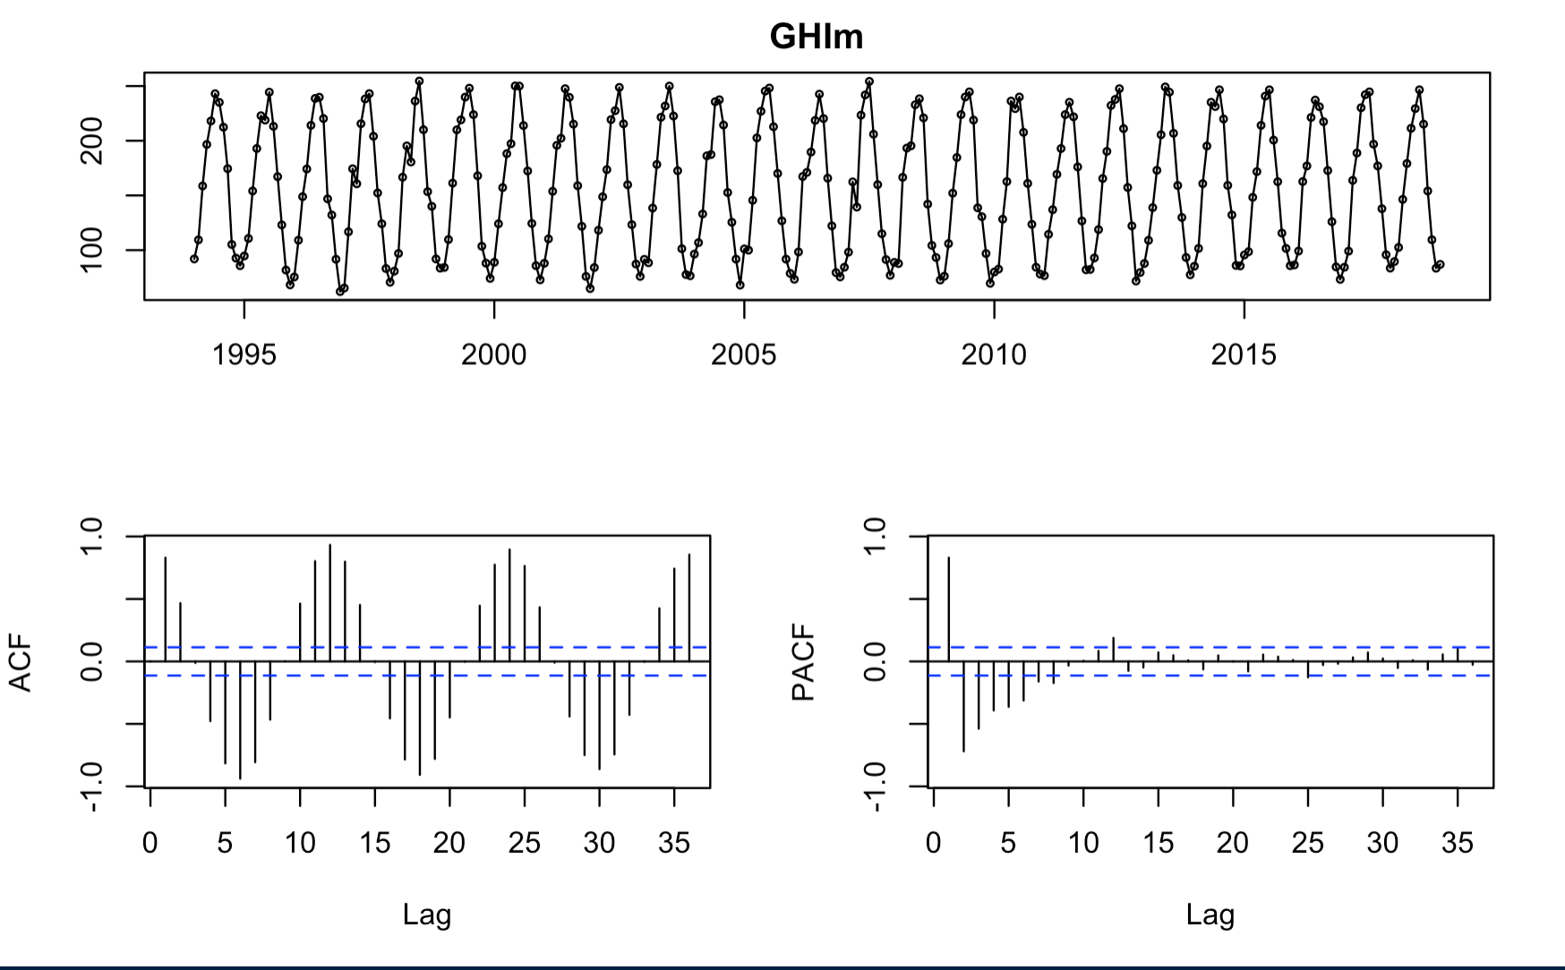
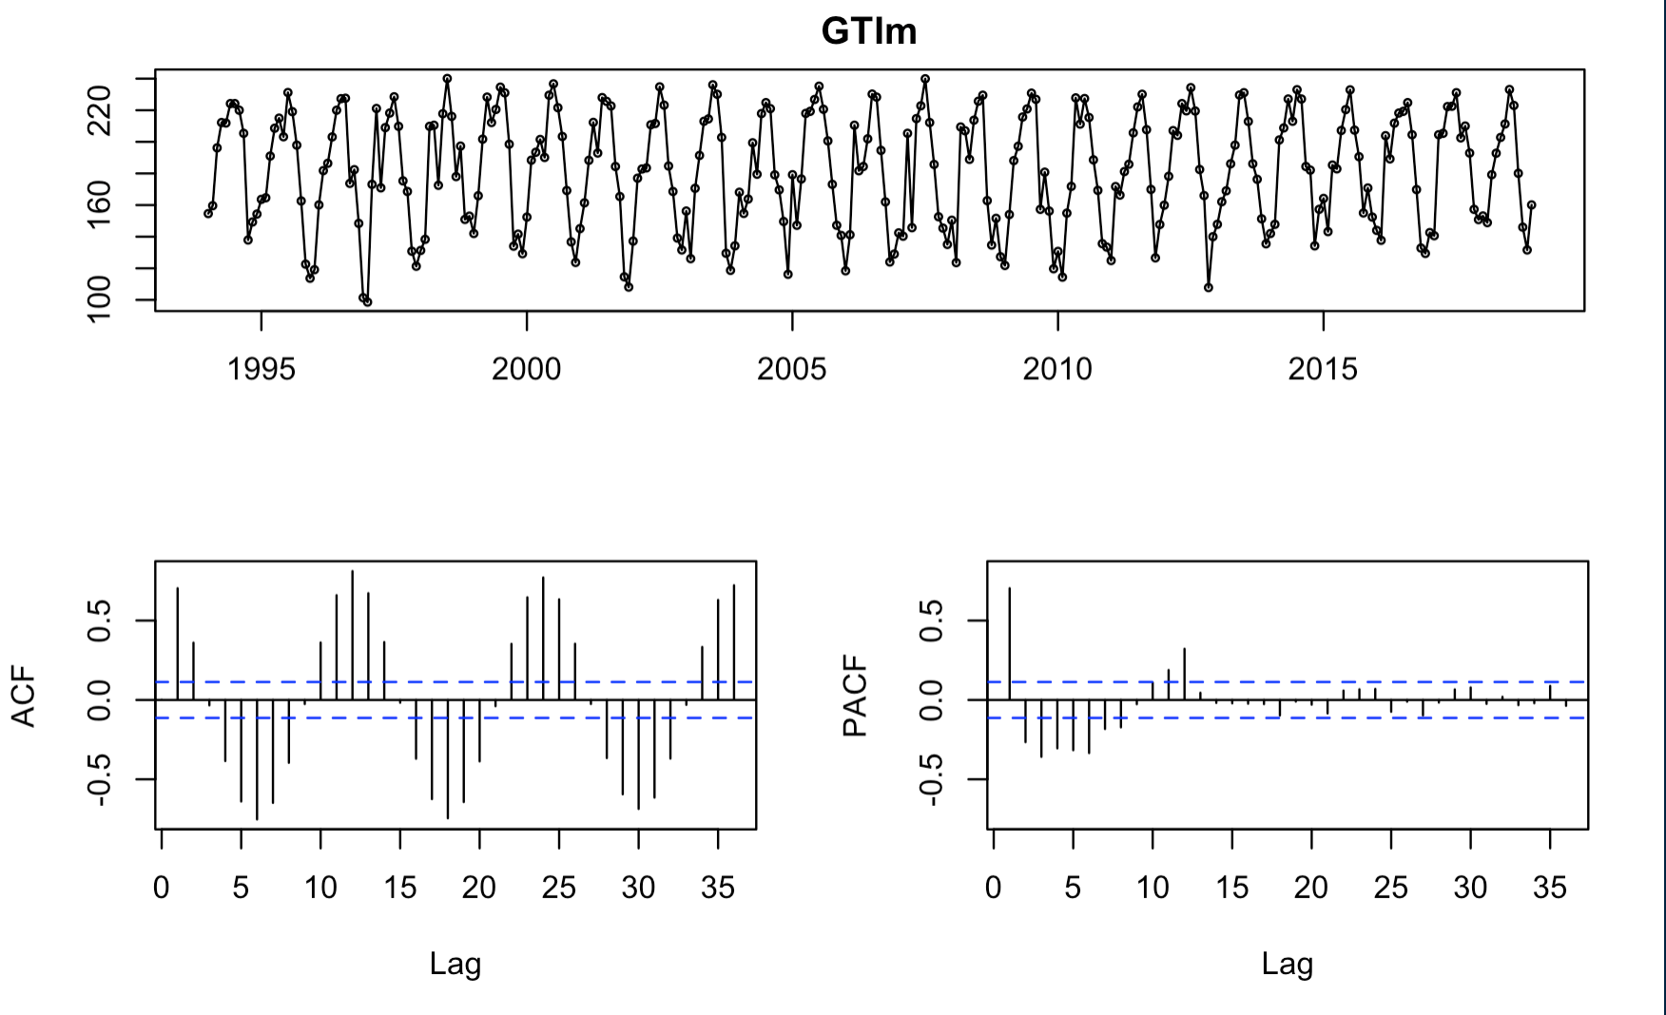
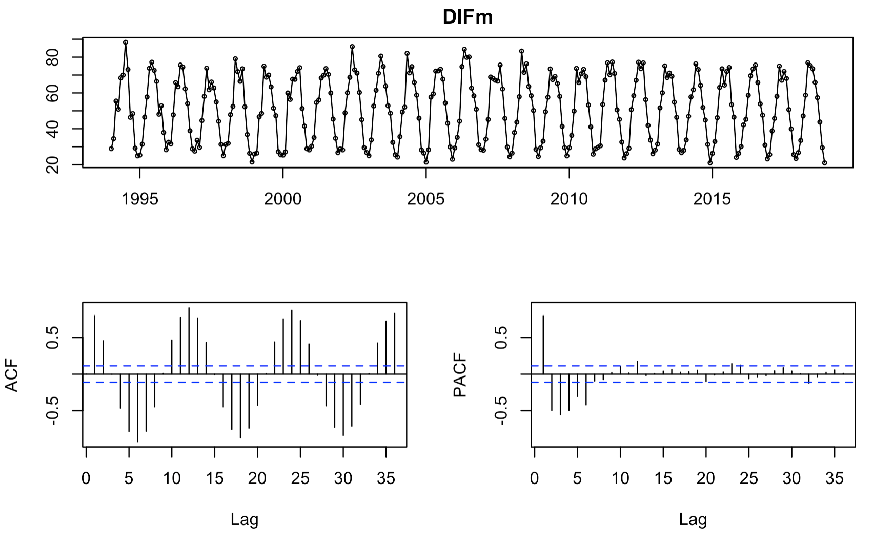
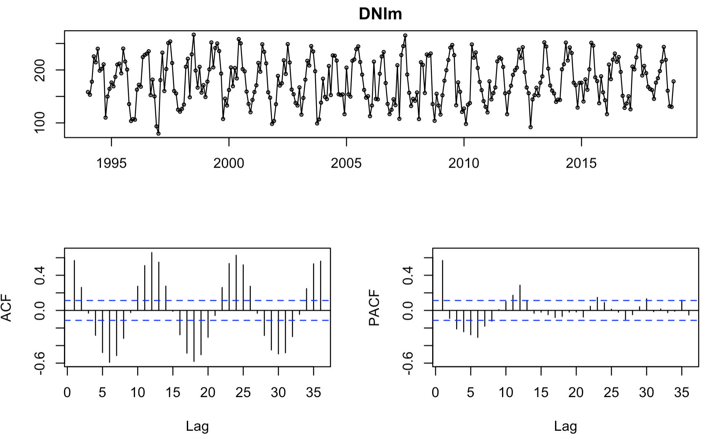
Time series plots/ ACF/PACF
GHIm
GTIm
DIFm
DNIm

Slide 12
Proposed Approaches
1. Linear Regression
5. Seasonal ARIMA
2. Regression with ARIMA errors
6. ARFIMA
3. Holt Winters
1
7. ETS
4. ARIMA
8. TBATS
9. GARCH

Slide 13
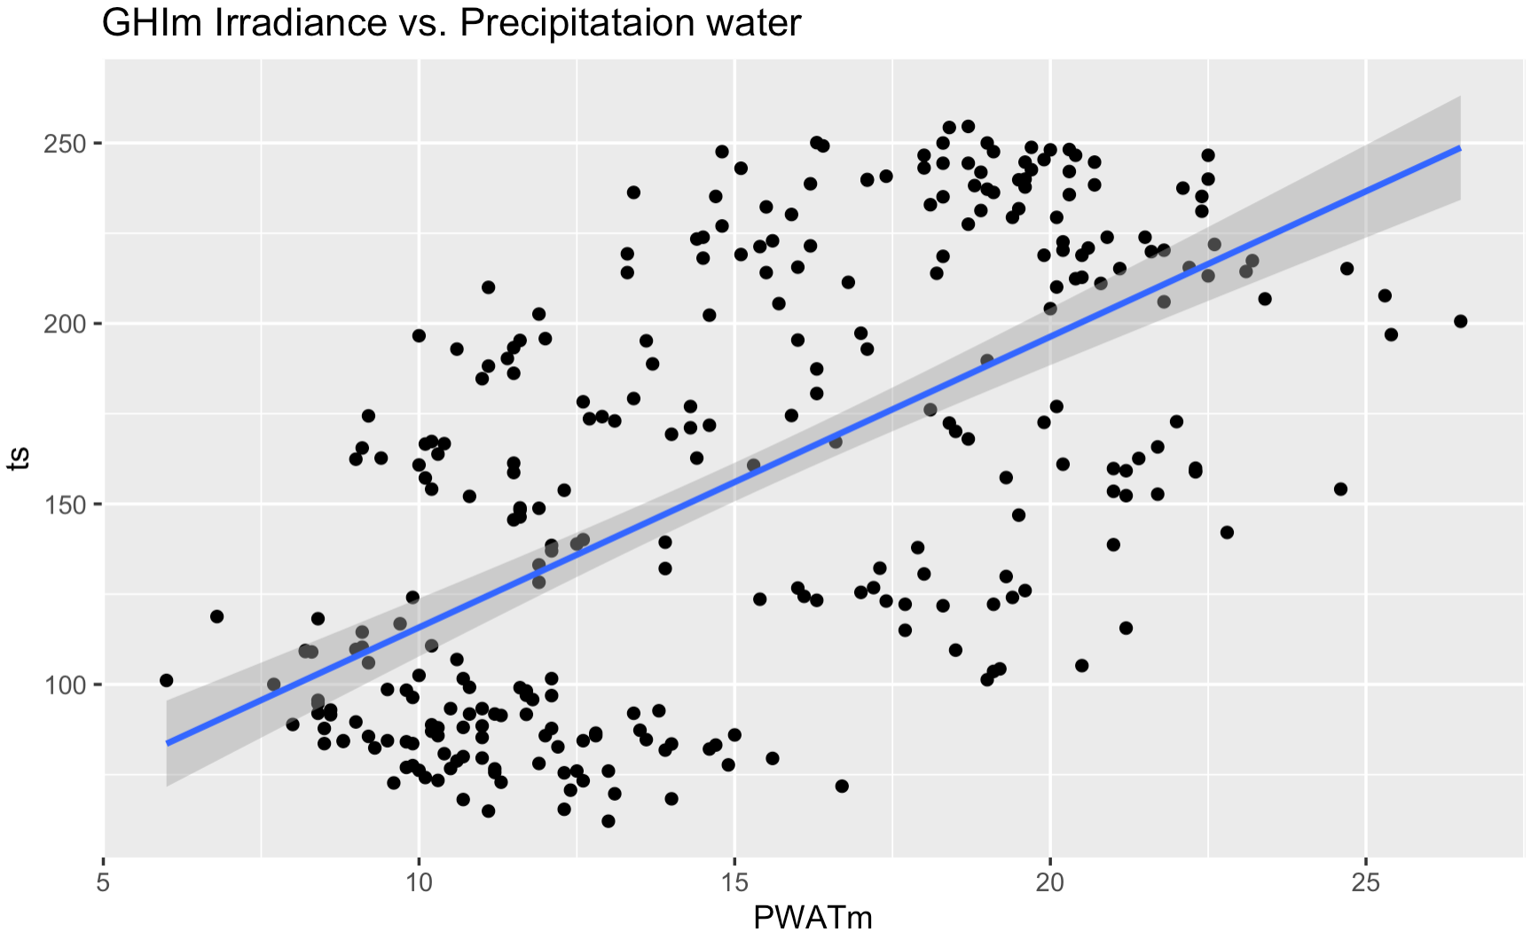
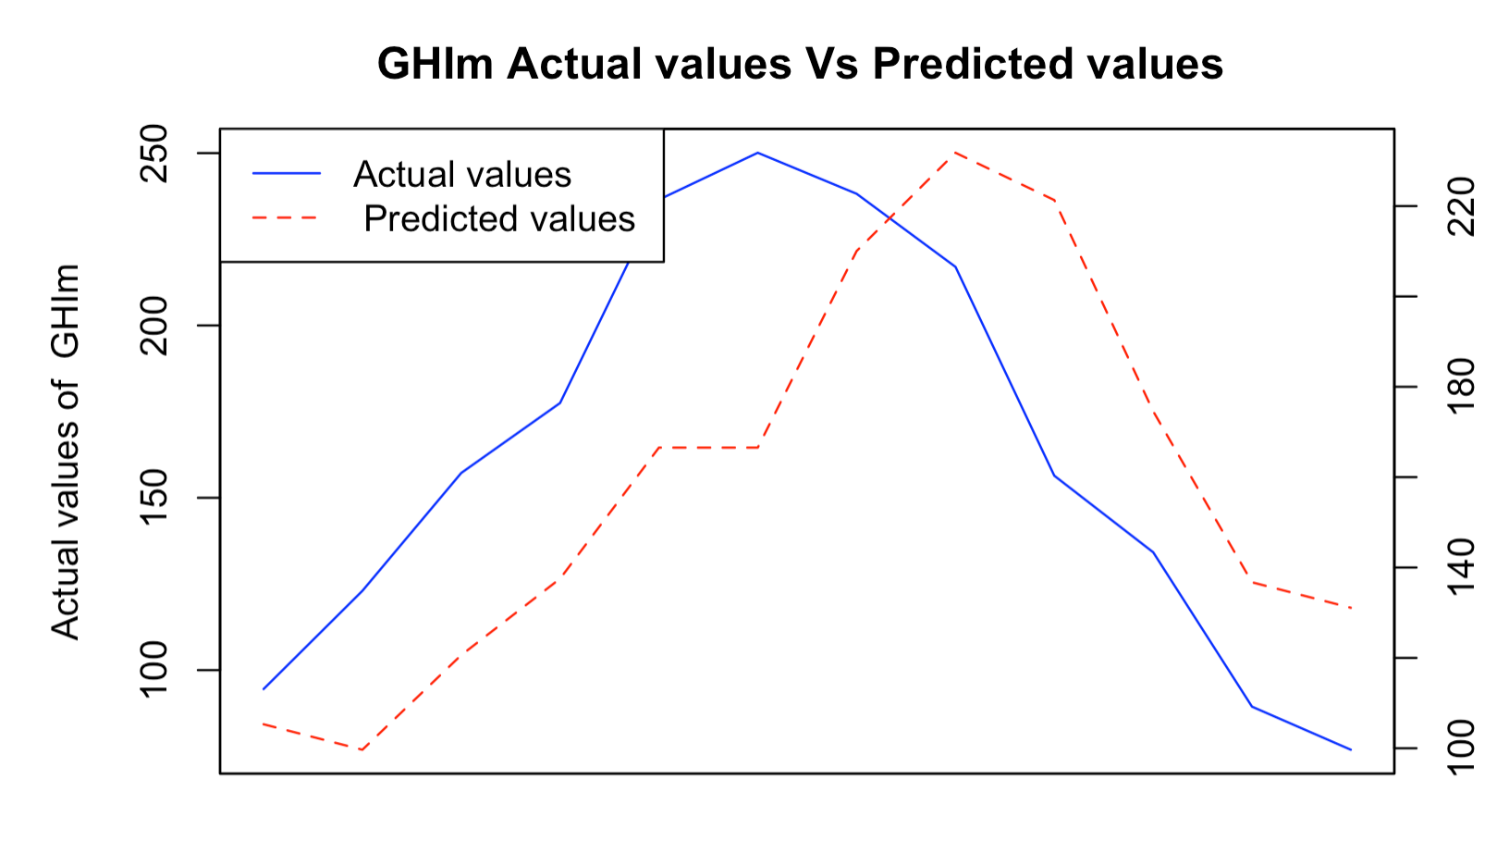
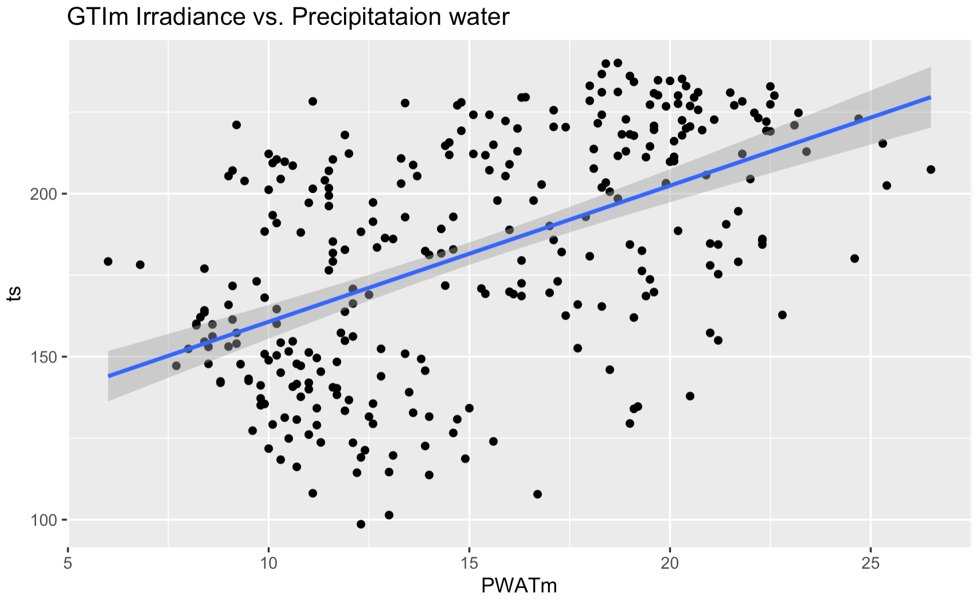
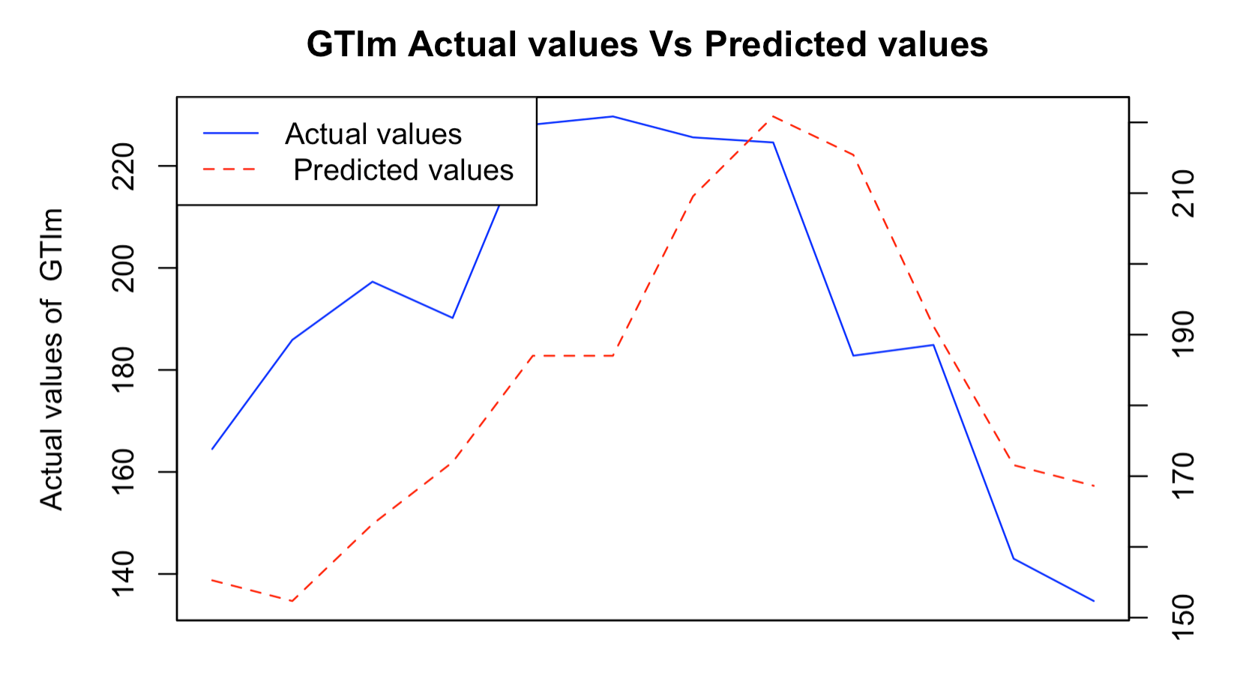
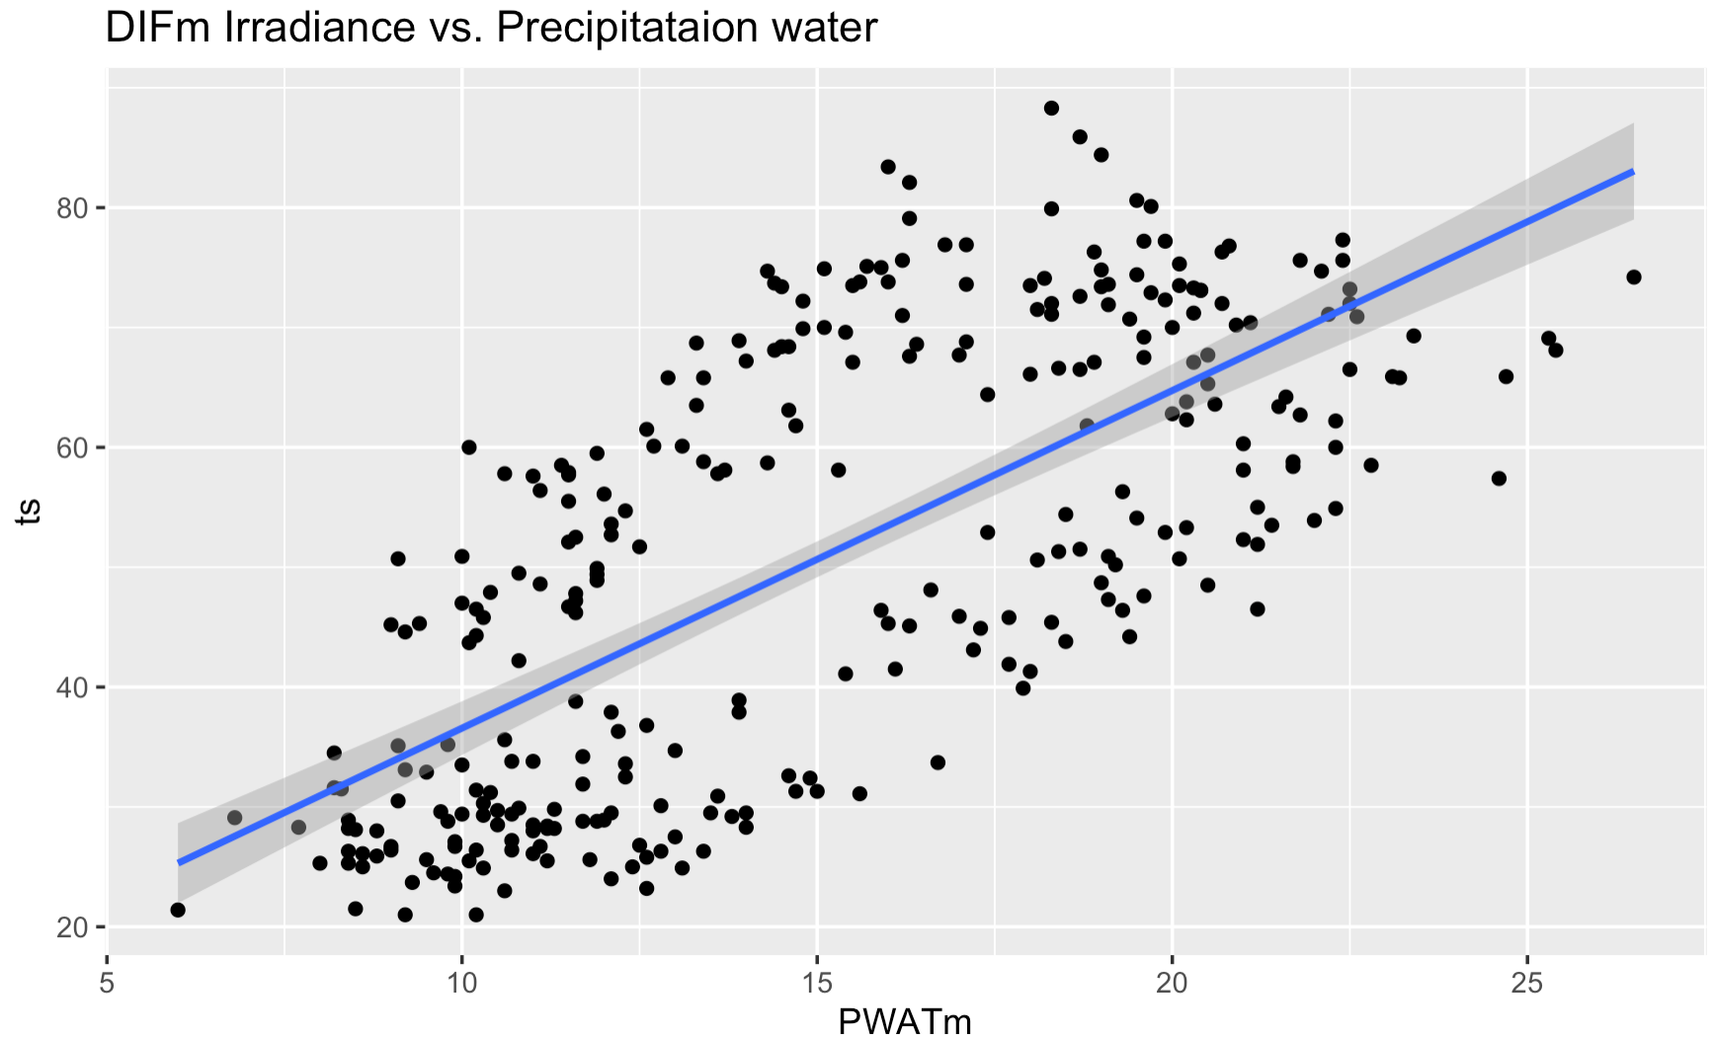
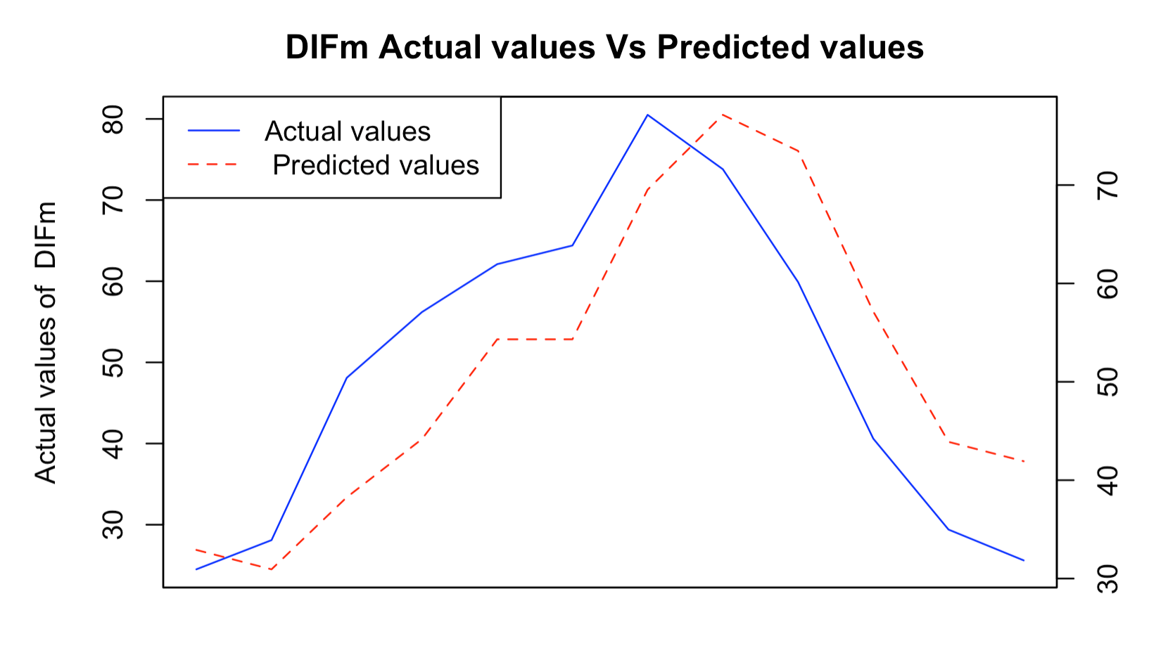
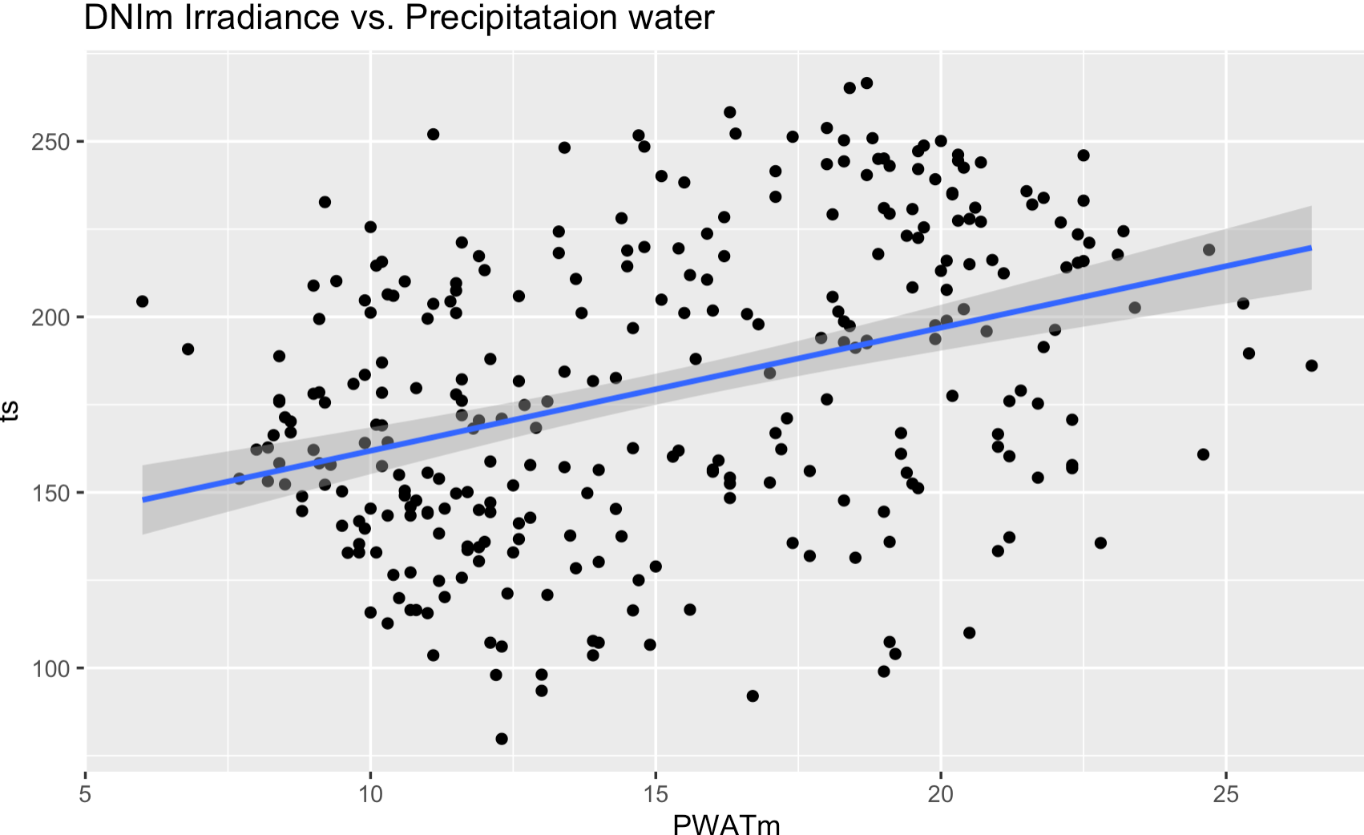
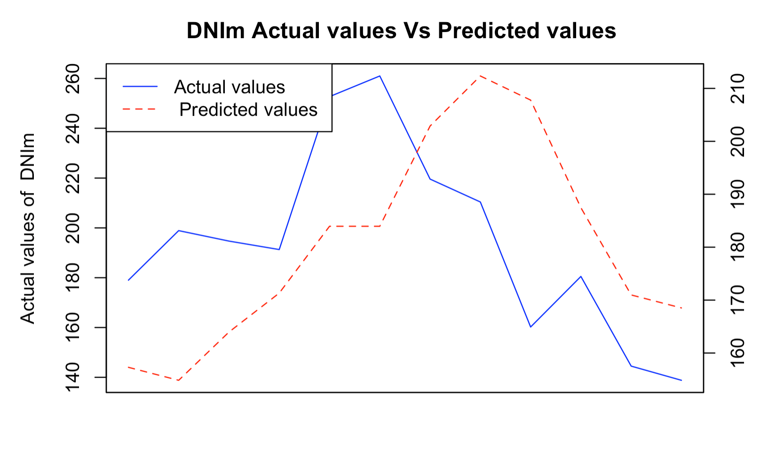
Linear Regression
GHIm
GTIm
DIFm
DNIm

Slide 14
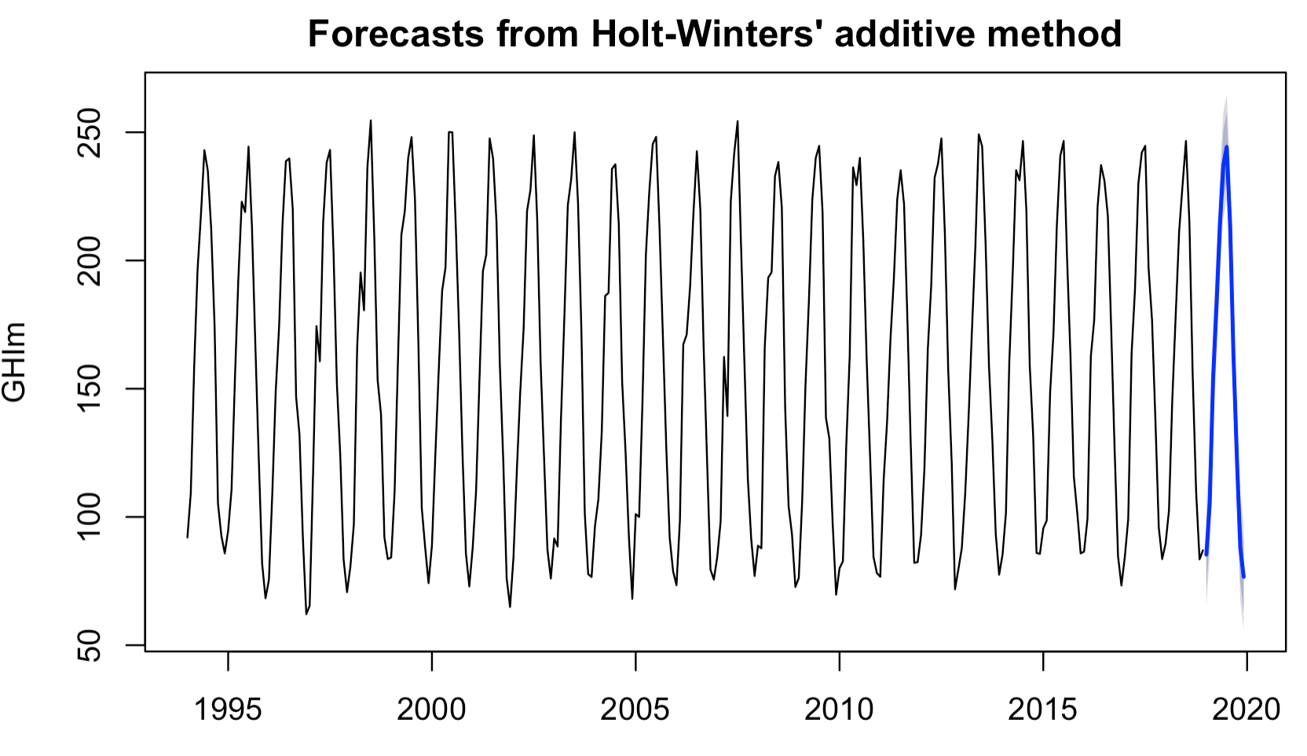
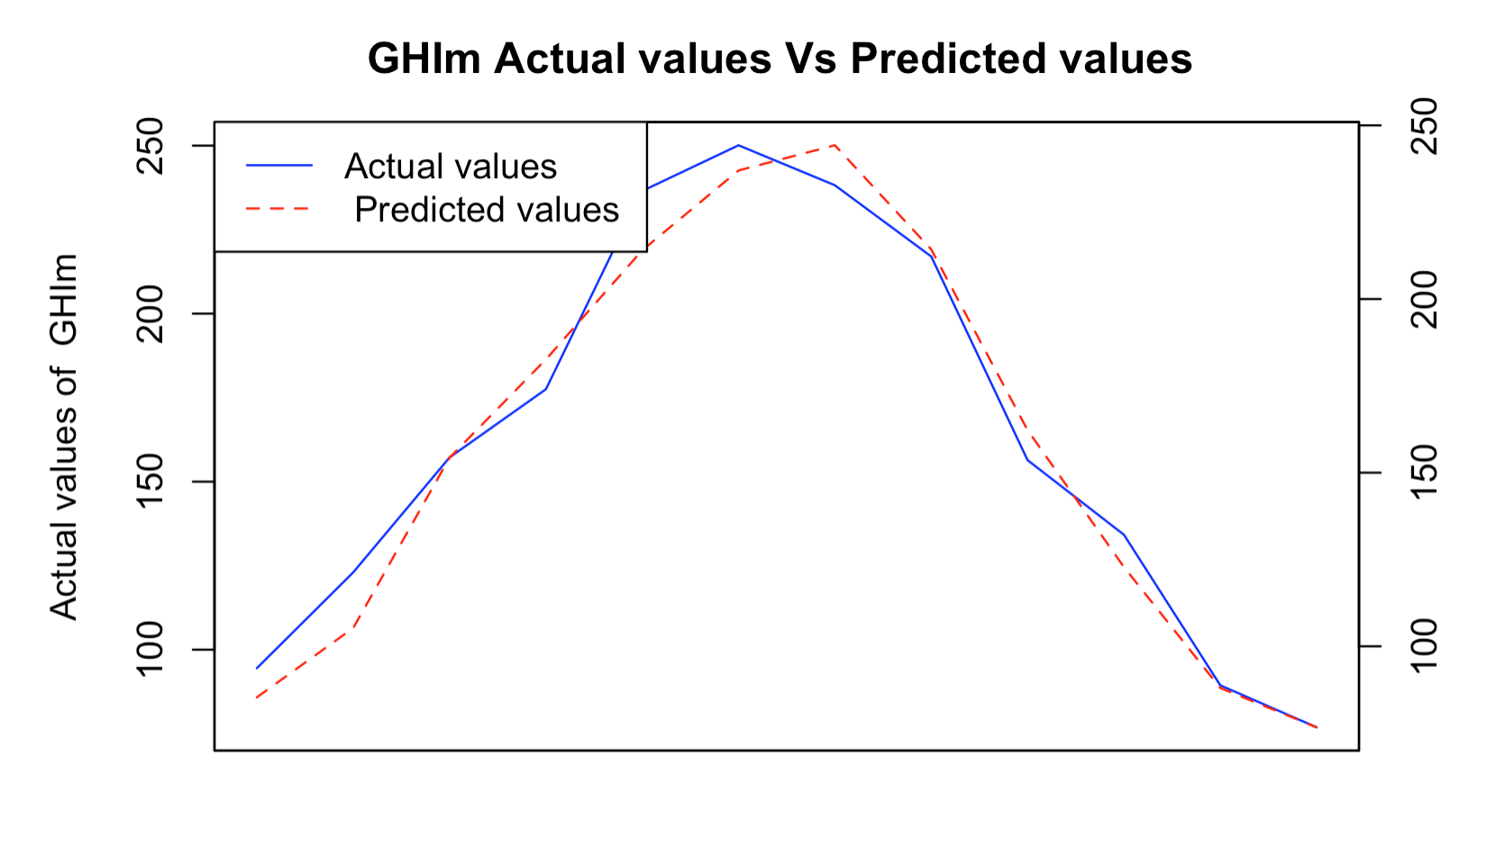
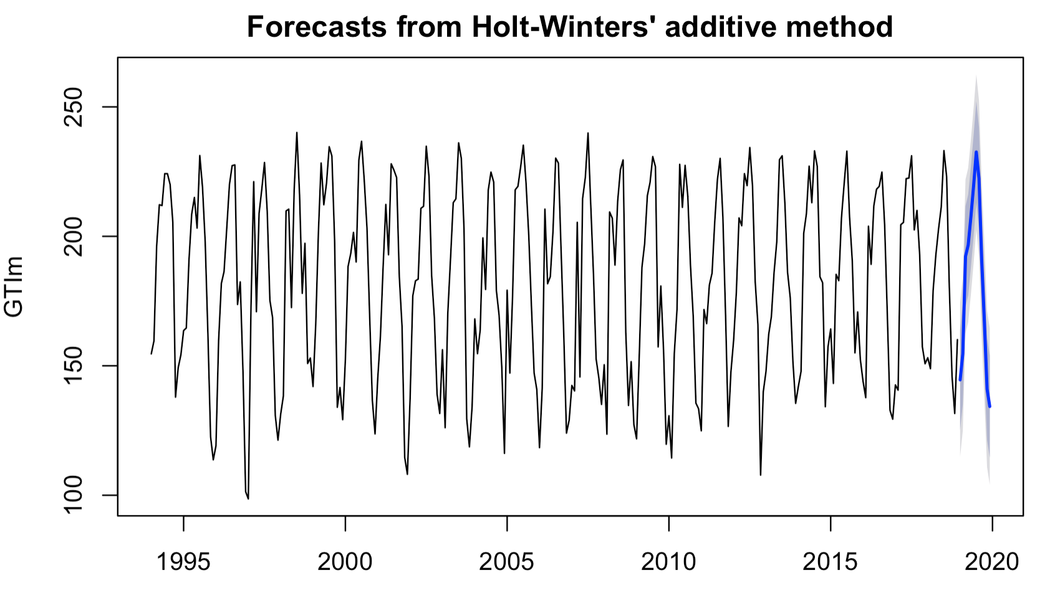
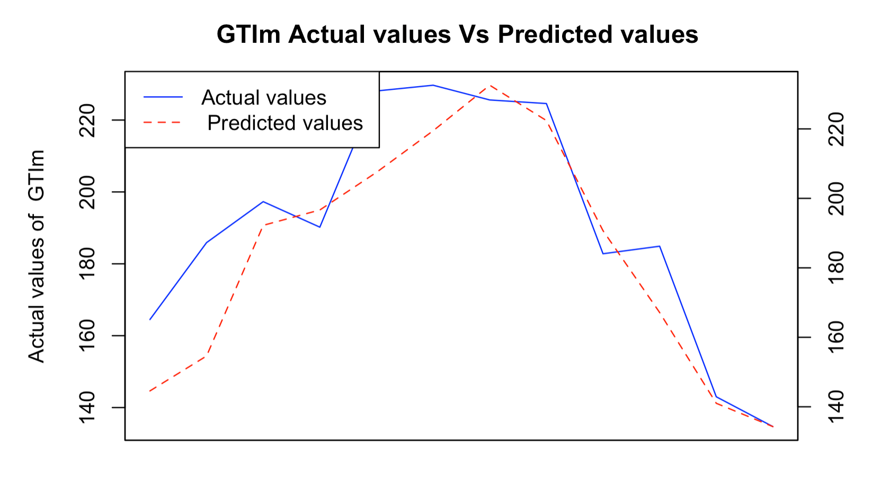
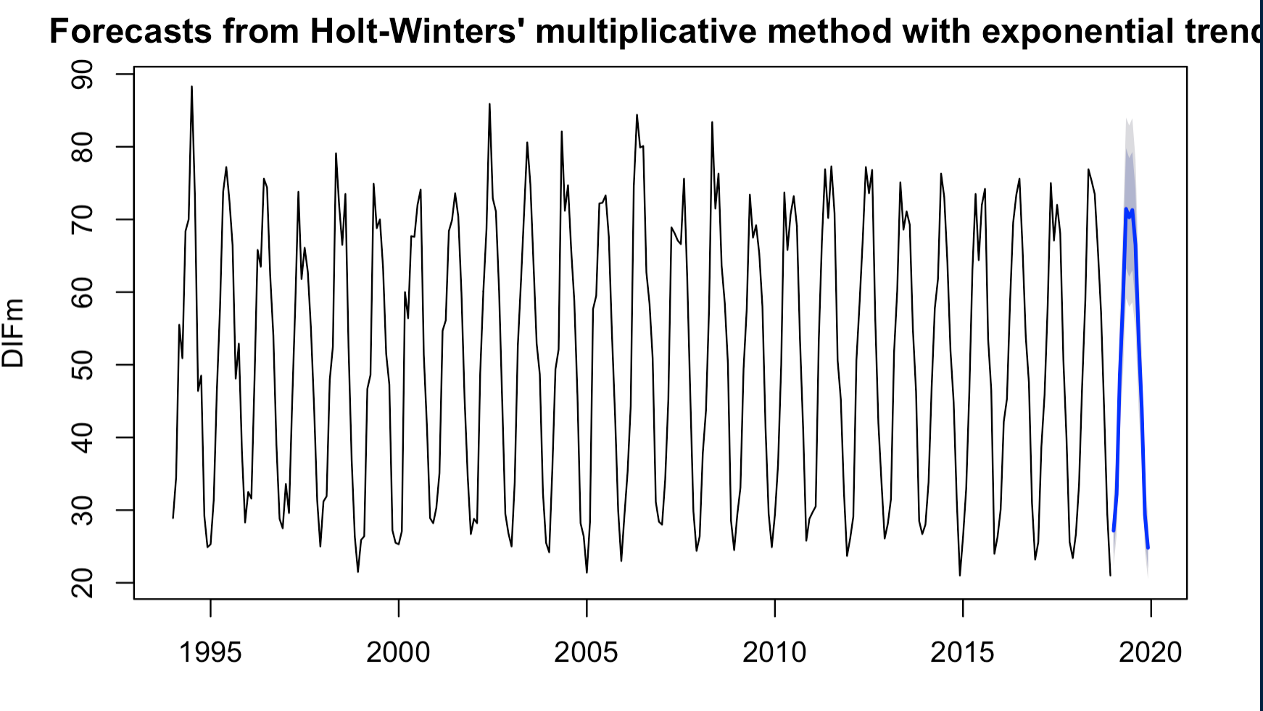
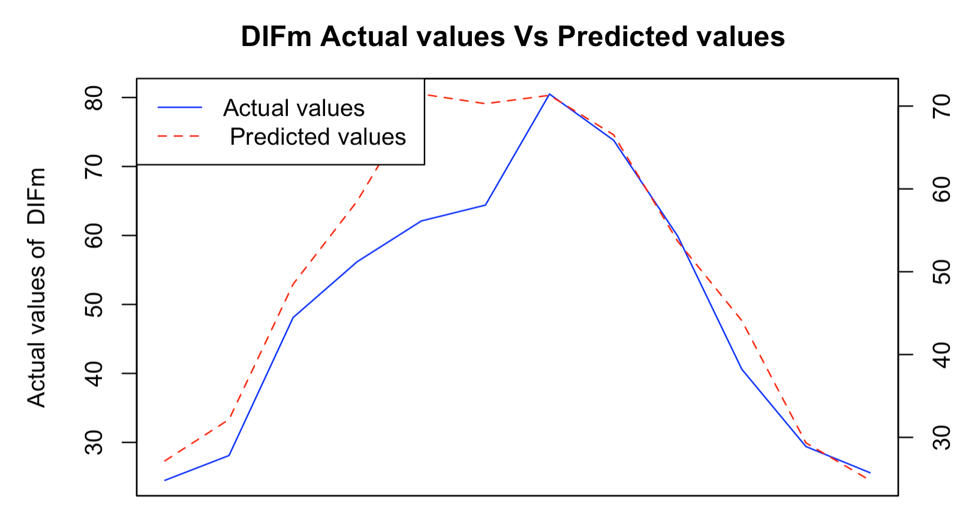
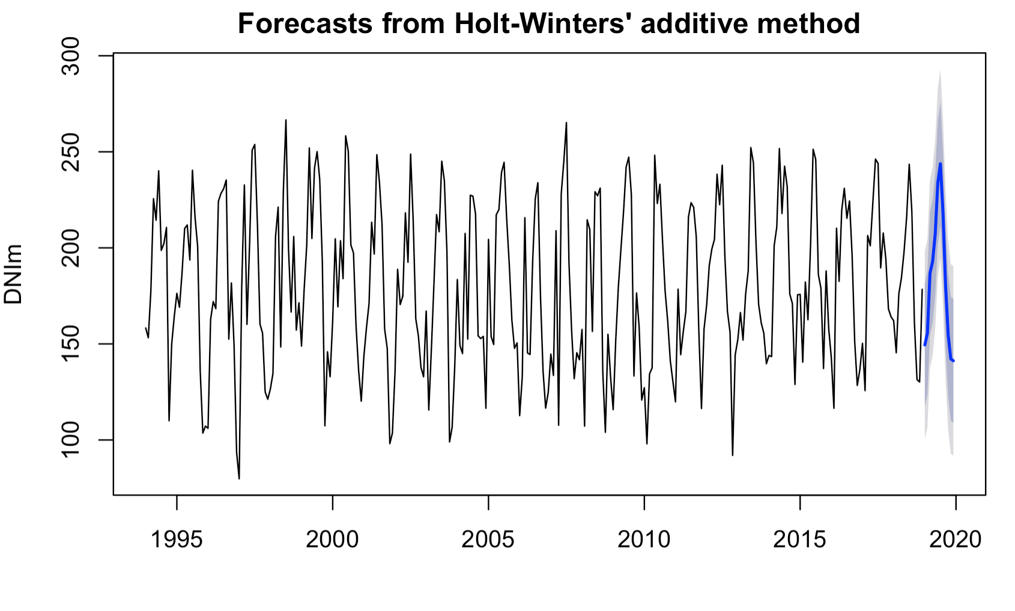
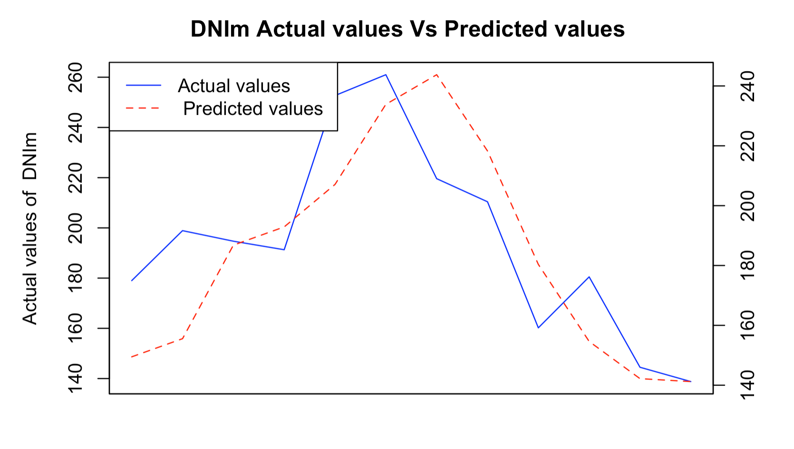
Holt winters
GHIm
GTIm
DIFm
DNIm

Slide 15
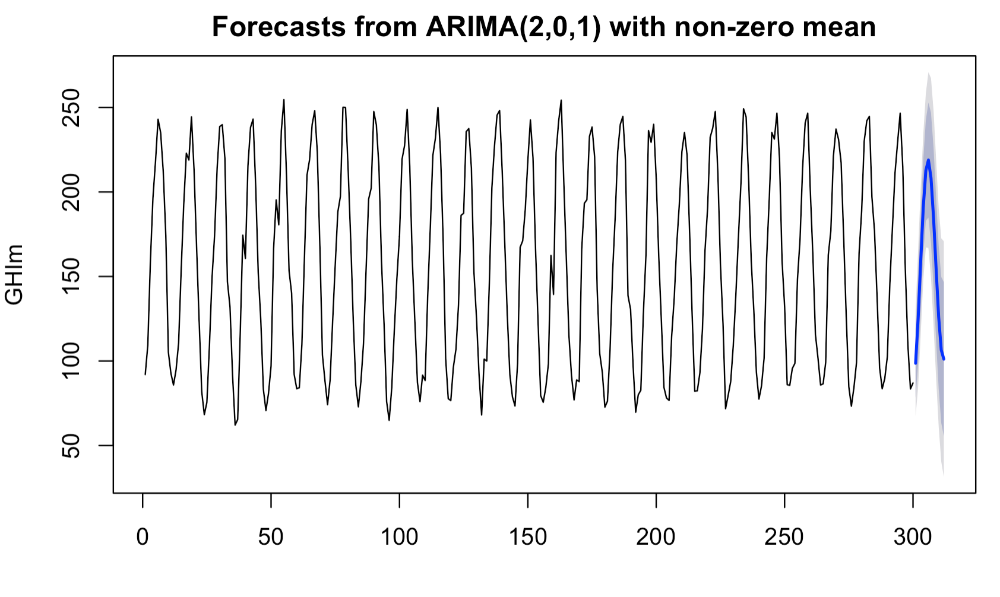
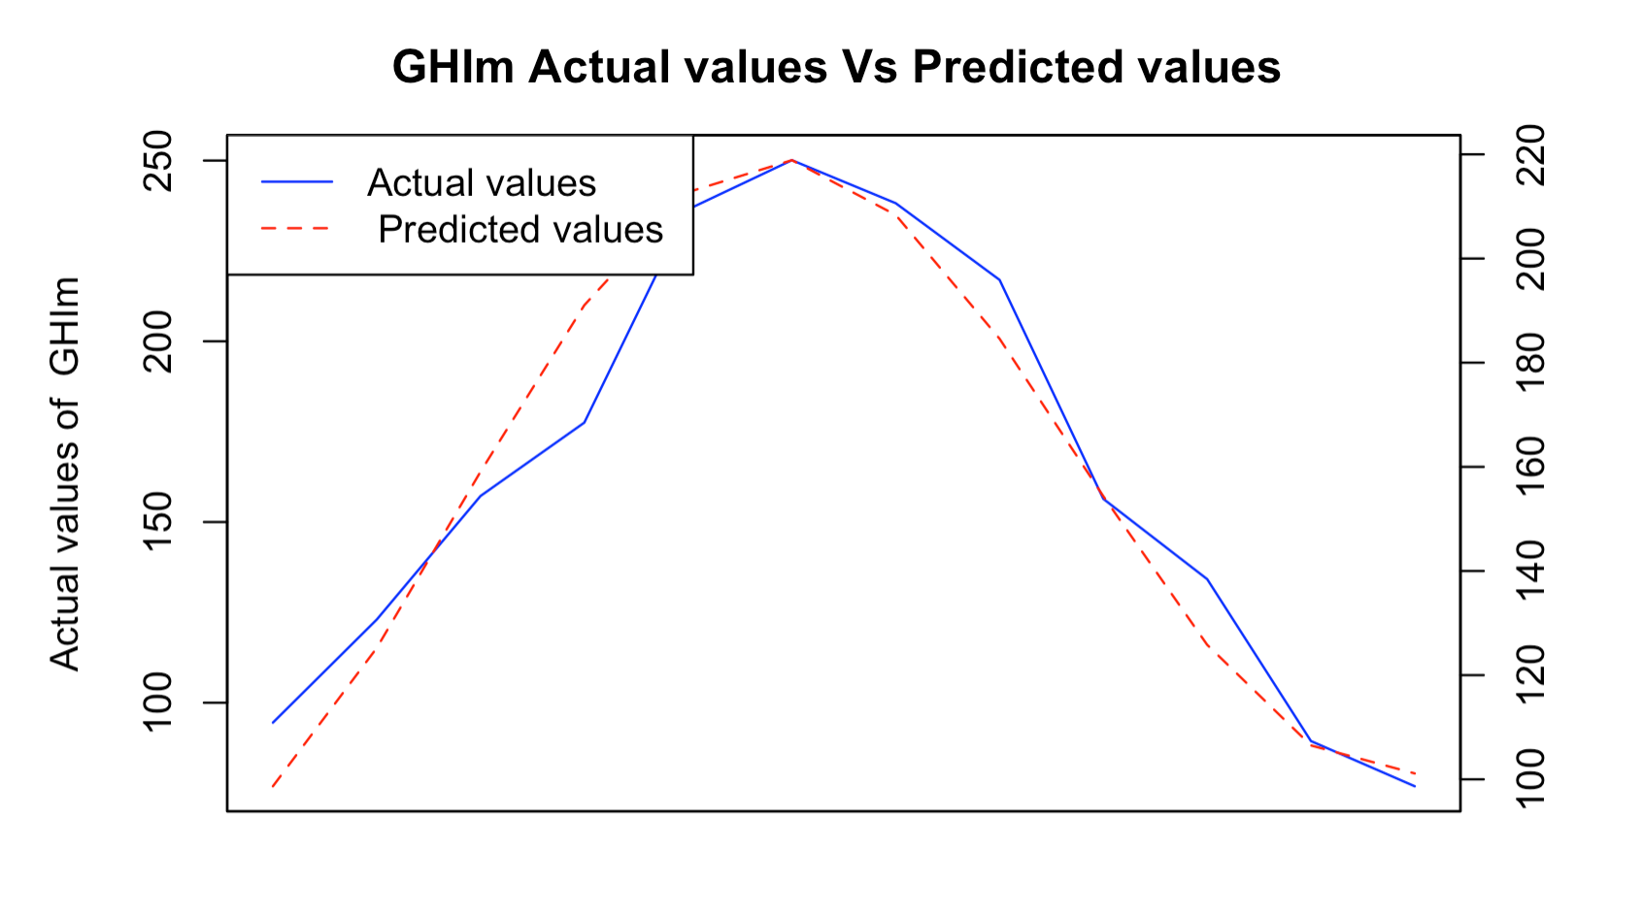






ARIMA
GHIm
GTIm
DIFm
DNIm

Slide 16
Seasonal ARIMA
GHIm
GTIm
DIFm
DNIm

Slide 17








Fractional ARIMA – long memory
decaying ACF
GHIm
GTIm
DNIm
DIFm

Slide 18




ARIMA with regression errors
GHIm
GTIm
DIFm
DNIm

Slide 19








TBATS model
GHIm
GTIm
DIFm
DNIm

Slide 20








ETS model ( State space models)
GHIm
GTIm
DIFm
DNIm

Slide 21







Vector Auto Regression
Granger causality

Slide 22








Vector Auto regression
GHIm
GTIm
DIFm
DNIm

Slide 23








Residual Analysis
Holt winters
Linear Regression
GHIm
GTIm
GHIm
GTIm
DIFm
DNIm
DIFm
DNIm
DIFm

Slide 24




Residual Analysis
ARIMA
SARIMA
GHIm
GTIm
GHIm
GTIm
DIFm
DNIm
DIFm
DNIm

Slide 25








Residual Analysis
ARFIMA
Reg with ARIMA errors
GHIm
GTIm
GHIm
GTIm
DIFm
DNIm
DIFm
DNIm

Slide 26








Residual Analysis
GARCH
TBATS
GHIm
GTIm
GHIm
GTIm
DIFm
DNIm
DIFm
DNIm

Slide 27



Residual Analysis
ETS
GHIm
GHIm
DIFm
DNIm

Slide 28




Residual Analysis
GHIm
GTIm
DIFm
DNIm

Slide 29





Error Analysis
SMAPE
RMSE
MAE
SSE
MAPE

Slide 30
Thank you

